Slide 1
In partnership with the Government of Japan
DRAFT - Healthcare Data Protection – Policies, Protocols, and Practices
Day 1
epihc.org

Slide 2
Speakers - Day 1 & Day 2
Facilitators
Dr. Ureshnie Govender
Dr. Sana Charania
Malvin Tshabalala
Workshop Subject Matter Experts
Dr. Prinesh Reddy
Dr. Brad Beira

Slide 3
Programme overview
1
The fundamentals of data security in healthcare
2
Regulations and guidelines in the digital health ecosystem
Day 1
3
The operating environment
4
Regulatory requirements for healthcare data
5
Guidelines and principles for data compliance and protection in operations
Day 2
6
Practical applications and examples for health data security

Slide 4
Day 1

Slide 5
Program schedule - Day 1
Item | Sub-item | Presenter | ~ Time
Welcome | Delegate welcome | IFC - YG | 10 min
 | Introduction and workshop flow | UG
The fundamentals of data security in healthcare | Introduction to cybersecurity & definitions | UG | 35 min
 | Self-Assessment & Maturity models | UG
 | John’s data journey and maturity self-rating scenario | MT
 | Comfort Break - 5 min
Regulations and guidelines in the digital health ecosystem | Introducing the digital health ecosystem | SC | 40 min
 | Digital health literacy in the digital health ecosystem | SC
 | John’s data journey and maturity self-rating scenario | MT
 | eHealth governance, standards and operability | UG
 | Comfort Break - 5 min
 | Healthcare data and the healthcare data journey | SC | 30 min
 | Interoperability in the digital health ecosystem | SC
 | John’s data journey and maturity self-rating scenario | MT

Slide 6
Program schedule - Day 1 continued
LEG STRETCH/COFFEE BREAK - 15 min
3. The operating environment | The digital health journey | MT | 45 min
 | Telemedicine vs Telehealth | MT
 | Electronic Health Records, mHealth and Social Media | MT
 | John’s data journey and maturity self-rating scenario | MT
4. Close | Feedback, Q&A session | UG | 20 min
 | Closing remarks | IFC

Slide 7
Program schedule - Day 2
Item | Sub-item | Presenter | ~ Time
Welcome | Delegate welcome | IFC | 45 min
 | Recap of day 1 and introduction of day 2 content | UG
Regulatory requirements for healthcare data | Definitions in the collection and processing of healthcare data | SC
 | Regulatory considerations surrounding healthcare data | SC
 | John’s data journey and maturity self-rating scenario | MT
 | Considerations for healthcare data collection and processing | MT
 | John’s data journey and maturity self-rating scenario | MT
 | Considerations for healthcare data access | MT
 | Comfort Break - 5 min
 | Healthcare data protection | UG | 40 min
 | Responsible persons in the protection of healthcare data | UG
 | John’s data journey and maturity self-rating scenario | MT

Slide 8
Program schedule - Day 2 continued
Item | Sub-item | Presenter | ~ Time
 | Considerations in healthcare data practice | MT
 | Comfort Break - 5 min
Guidelines and Principles for data compliance and protection in operations | The transfer of healthcare data | UG | 40 min
 | General principles in transferring and exchanging healthcare data | UG
 | The importance of interoperability revisited | UG
 | John’s data journey and maturity self-rating scenario | MT
 | Organisational considerations in transferring and exchanging healthcare data | UG
LEG STRETCH/COFFEE BREAK - 15 min
Guidelines and Principles for data compliance and protection in operations cont. | Key definitions in understanding data breaches | SC | 45 min
 | Data breaches in healthcare | SC
 | Responding to a data breach | SC
 | John’s data journey and maturity self-rating scenario | MT
 | Organisational considerations in transferring and exchanging healthcare data | UG
 | Comfort Break - 5 min

Slide 9
Program schedule - Day 2 continued
Item | Sub-item | Presenter | ~ Time
Practical applications and examples for health data security | Case studies of data breaches in healthcare | UG | 35 min
 | Conclusions and Key Takeaways | PR/BB
 | Comfort Break - 5 min
Close | Feedback, Q&A session | UG | 15 min
 | Closing remarks | IFC

Slide 10
Your expectations for the workshop
Expectations
What are your:
expectations?
learning outcomes you would like achieve?
key questions that you would like answered?

Slide 11
The key message of the workshop - The 3 important P’s
Safeguarding information & data security
The users of the platforms in the ecosystem.
The technology used in the ecosystem.
People
Process
Product
How the users interact in the ecosystem.

Slide 12
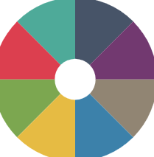
Medicine vs Health
Medicine vs Health
“Health is a state of complete physical, mental and social well-being and not merely the absence of disease and infirmity” - Alma Ata declaration – WHO
“Medicine refers to the field of study and practice focused on diagnosing, treating, and preventing diseases and ailments in individuals” - NIH
How do we define a consultation?
Can a virtual consultation be part of value-based care?
Is Telehealth person centric interoperable care?
Notes:
References
Alma-Ata declaration
NIH - Medicine

Slide 13
John’s data journey and maturity self-assessment
Throughout the workshop we will be following “John”
Johan is a patient who is in the healthcare ecosystem and is navigating different scenarios that expose his data to different security risks.
Additionally, after every section, the audience will be asked to self-assess their maturity
Aim: After the workshop the audience will have a holistic view of their cybersecurity maturity across different elements of the digital health ecosystem.

Slide 14
Practical scenario on the importance of health data protection
John’s data journey will involve your feedback via polls, feedback via the zoom chat function or sharing verbally.
We will prompt you to respond during each scenario
Look out for clues in each scenario
Bring lots of Energy
Ask as many questions as you want

Slide 15
Meet John, our digital health user
John
28 years old
Interested in technology and regularly uses digital health applications to manage his health
Lives in Castle Republica (EU)
Has a chronic heart condition
Currently on ARV treatment - His family does not know

Slide 16
Characters and entities in John’s scenario
Dr. Ramos
June
Triangle EHR
Johns primary physician
Pharmacy assistant & Johns sister
EHR survive provider
Dr. Shari
Craig
Regulator
Data protection regulator
Supporting physician
Johns supporting physician
Jane
Care Facilities
Rombus mHealth
The RED
Hospital
The BLUE
Hospital
The YELLOW Hospital
Data Protection Officer
mHealth Provider

Slide 17
1
The Fundamentals of Data Security in Healthcare

Slide 18
1
The Fundamentals of Data Security in Healthcare
Introduction: Interactive session discussing the importance of protecting healthcare data. Definitions of personal data Cybersecurity and cyber resilience: Increasing incidents of cyber attacks in healthcare and their targeting of patient data. Self-assessment: Introduction of self-assessment frameworks. Audience self-rating: Audience asked to give an estimation of their maturity in cybersecurity. Interactive session - Scenario 1: Brief feedback session and experience sharing from audience regarding the aforementioned topics.
2
Regulations and guidelines in the Digital Health Ecosystem
3
The operating environment
4
Regulatory requirements for healthcare data
5
Guidelines and principles for data compliance and protection in operations
6
Practical applications and examples for health data security

Slide 19
Why is the protection of healthcare data important ?

Slide 20
Definitions of personal data
General Data Protection Regulation (GDPR)
“Any information relating to an identified or identifiable natural person. Identifier such as a name, an identification number, location data, an online identifier or to one or more factors specific to the physical, physiological, genetic, mental, economic, cultural or social identity of that natural person” - Article. 4 GDPR, (1)
Health Insurance Portability and Accountability Act (HIPAA)
“Referred to as Protected Health Information (PHI). An individual’s health, treatment, and payment information, and any further information maintained in the same designated record set that could identify the individual or be used with other information in the record set to identify the individual” - Sections 261 to 264
Notes:
GDPR
GDPR Articels
GDPR - WHO, Microsoft, PwC, Technology
HIPAA, PHI, HIPAA Privacy Rule -
Setting the scene and ensuring that everybody is on equal footing irrespective of location
HIPAA - North Ameria

Slide 21
Definitions of personal data
Protection of Personal Information Act (POPIA)
“Information relating to an Identifiable, living, Natural person, and where it is applicable, an identifiable, existing juristic person. Including but not limited to:
Race, gender, sex, pregnancy, marital status, national, ethnic or social origin, colour, sexual orientation, age, physical or mental health, well-being, disability, religion, conscience, belief, culture, language, birth;
Education or the medical, financial, criminal, employment history;
Identifying number, symbol, e-mail address, physical address, telephone number, location information,
Online identifier, biometric information,
Personal opinions, views or preferences
POPI Act 2013, Chapter 1, Section 1
Other: PIPEDA (Canada), DPBI (India)
Notes:
POPI Act , POPI Definitions , Personal Information Protection and Electronic Documents

Slide 22
Health data definition
Health data
“health data are to be classified as sensitive personal data, or personally identifiable information, that require a high safety and security standard.
WHO Global strategy on digital health, 2021
“Any information that describes or reveals the past, present, or future physical health, mental health, disability, diagnosis, or healthcare treatment of an individual” - American Data Privacy and Protection Act, 2022
“Patient health information includes any personal information about an individual held by a covered entity” - HIPAA
Notes:
References
Health data definition
WHO Regulation & Definition
International Association of Privacy Professionals Definition
HIPAA: Defining covered entities as health care providers and health insurers. Given that, health information is any personal information about an individual held by a covered entity. It doesn’t matter if the information is the patient’s diagnosis or the color of the patient’s car. It’s all protected the same under HIPAA. But, when HIPAA-protected information is transferred to someone outside of HIPAA, the privacy rules do not follow the information, and no privacy protections may apply. This approach has its shortcomings, but we know absolutely what information is regulated in the hands of HIPAA covered entities. That is not the case with the ADPPA.
Personal data is health data, but health data is not personal data! And the regulations classify health data differently….how does this transition across jurisdictions locally and globally…NB. Where health data fits in personal data!

Slide 23
Cybersecurity
“Cyber threats to healthcare organisations are steadily growing” - Forbes, 2021
Cyber resiliency
“the ability to anticipate, withstand, recover from, and adapt to adverse conditions, stresses, attacks, or compromises on systems that use or are enabled by cyber resources”
National Institute of Standards and Technology (NIST)
Small
Medium
Large
Increasingly targeted
Greater capacity for cyber resilience
Underestimating the risk
Lack of skills and knowledge
Lack of resources
Rapid pace of technology advancement
Conflicting / excessive cybersecurity information
Lack of perseverance/consistency
Notes:
References
Forbes Personal Data Protection , NIST Cyber Resiliency Definition
Cybersecurity maturity: is a measure of the ability of a utility to protect its assets from harm
SME are Increasingly targeted by online threats because they are perceived as being inherently more vulnerable.
Health data is a target for cyber criminals….importance of cyber resilience….to be preparedness and implement safeguards against exploitation…collection of much data…irrespective of the organization size, you are still a target…it is also critical to understand the security measures and cyberresilience when using products and platforms eg. cloud tech

Slide 24
Cybersecurity maturity models
Maturity models | Territory
ISO 27001 (ISMS) | Global standard
Capability Maturity Model Integration (CMMI) | Global
Control Objectives for Information and Related Technologies (COBIT 2019) for Information Security | Global
The Australian Signals Directorate (ASD) | Australia
National Institute of Standards and Technology (NIST) - CSF | Global
Sectoral Cybersecurity Maturity Model (SCMM) CyberSecurity Framework (CSF) | Global
Health Information Trust Alliance (HITRUST) CyberSecurity Framework | Global
Non-exhaustive list
Notes:
As threats grow, understand your cybersecurity maturity….we are not subscribing to a particular model…no one size fits all…
CMMC Cybersecurity Maturity Model , Cybersecurity Models, CMM Models, CMM Models , The Australian Signals Directorate (ASD)
The protection of the healthcare data
There are many maturity models in existence today, and none of them is one-size-fits-all maturity model
Cybersecurity maturity: ISO 27001 plays a crucial role - Best Known Standard in Information Security Management
It provides a roadmap for organizations to assess their current level of cybersecurity, identify potential vulnerabilities, and implement strategies for continuous improvement. It ensures that systems are adequately protected by recommending the implementation of a wide range of parameters essential to information security

Slide 25
Self assessment - Different frameworks for different functions
Assessment Type | Process measurement: IT process governance | Information security: Regulatory compliance and risk management | Process measurement: Software development, acquisition & maintenance | Cybersecurity: Management guidelines
Maturity Model Name | COBIT 2019 | HITRUST | CMMI | NIST-CSF
Applicability | SMEs: COBIT for Small and Medium Enterprises | Highly adopted in healthcare. Designed for scalable but can be difficult for smaller organisations (~$36 000) | SMEs: Comprehensive but applicable for SMEs. Challenges with affordability & expert need when implementing | SMEs: NIST Interagency Report (NISTIR)
 | Large organisations COBIT 2019 |  |  | Large organisations NIST-CSF
Level description | 5-Level model Non-existent Initial/ad hoc Repeatable but intuitive Defined process Managed & measurable Optimized | 5-Level model Policy Procedures Implemented Measured Managed | 5-Level model Incomplete Initial Managed Defined Quantitatively managed Optimised | 4-tier model Partial Risk informed Repeatable Adaptive
Well described
Trained
Regular
Consistent
Notes:
Maturity assessment allows for continuous assessment of vulnerabilities and potential breaches …customised approaches for small organisations…understand were you can customise, the cost, and the use ie. what you need to achieve now….follow through from being to end…also be aware that partner organisations require adherence to one or more of the maturity model eg. HITRUST certification required for US organisations

Slide 26
Engagement session
Which cybersecurity maturity framework do you (or would you) use and why?
If you don’t have a maturity framework , give a rough estimation of how mature you think you may be?
Incomplete
Standardised
Optimised

Slide 27
Reflection:
What are lessons learned when trying to improve in maturity?
For those that have used different models, what are some of your experiences?

Slide 28
Scenario 1 | John’s data journey: Introduction of new applications
Doctors
John’s doctors work at The RED Hospital
The RED Hospital is trying to be a digitally enabled hospital
The RED Hospital recently introduced a new EHR platform, Triangle EHR. It is new on the market with AI and enhanced AI features, Big Data capacity and is flexible for user customisation.
Although some of the SOPs and functionality are still being drafted, Triangle EHR, has been officially rolled out.
Staff are encouraged to attend a 30-min Triangle EHR introductory training session.
The doctors and nurses are struggling to use it.
The clinical staff regularly ask the IT department for assistance accessing patient records and updating health information.

Slide 29
Scenario 1 | Maturity self-rating
Self-assessment
What cyber resilience risks can you identify in The RED Hospital from this scenario ?
How can these risks potentially risks extend to/affect John ?
Depending on your chosen model, how would you rate your organisation’s maturity in implementing preventive measures to avoid similar situations to those in the scenario ?
Notes:
Staff training:
80 percent of the security breaches in the healthcare sector since the enactment of HIPAA trace back to people within the organization, Improvement on training to make it current, relevant, and intelligence-based (inclusive of both in-house and external sources) and improve staff situational awareness, Human behavior and simple mistakes, regardless of industry, are a large factor in data loss - Maturity Model for healthcare organisations, 2021

Slide 30
5 min Break

Slide 31
2
Regulations and guidelines in the digital health ecosystem

Slide 32
1
The Fundamentals of data security in healthcare
The digital health ecosystem: An introduction to the digital health ecosystem and the different elements of the ecosystem. Digital health literacy: Key definitions in digital health. Introduction to computer literacy with some practical clinical examples. Cyber threats and cyber resilience frameworks to support health organisations. Interactive session - Scenario 2: John’s data journey and maturity self-rating scenario Governance: The transition of data governance over different regions. Standards and interoperability The healthcare data journey. The importance of standard and interoperability in the digital healthcare ecosystem. Interactive session - Scenario 3: John’s data journey and maturity self-rating scenario
2
Regulations and guidelines in the Digital Health Ecosystem
3
The operating environment
4
Regulatory requirements for healthcare data
5
Guidelines and principles for data compliance and protection in operations
6
Practical applications and examples for health data security

Slide 33
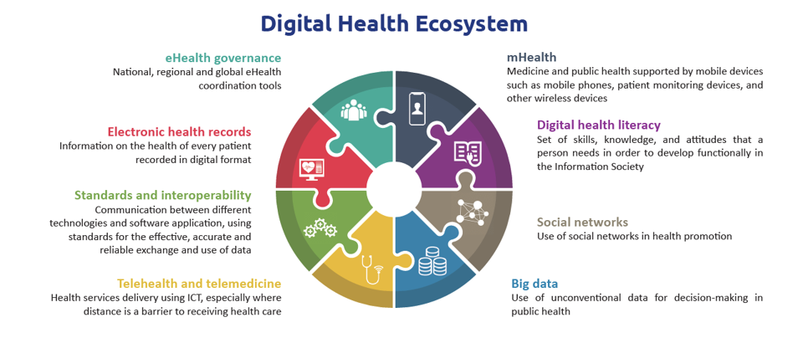
The digital health ecosystem
The therapeutic world we now live in
WHO
Notes:
Digital Health Ecosystem
https://iris.who.int/bitstream/handle/10665/311941/9789241550505-eng.pdf?sequence=31

Slide 34
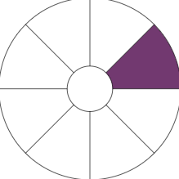
Digital health literacy

Slide 35
Digital health literacy
eHealth literacy
“the ability to appraise health information from electronic sources and apply the knowledge gained to addressing or solving a health problem”
eHealth Literacy: Essential Skills for Consumer Health in a Networked World, 2006
“ the ability to seek, find, understand, and appraise health information from electronic sources and apply the knowledge gained to addressing or solving a health problem”
- eHealth literacy among hospital health care providers: a systematic review, 2023
Notes:
What is e in eHealth, what is Health…explain. Digital systems have grown especially for health hence key to understand……

Slide 36
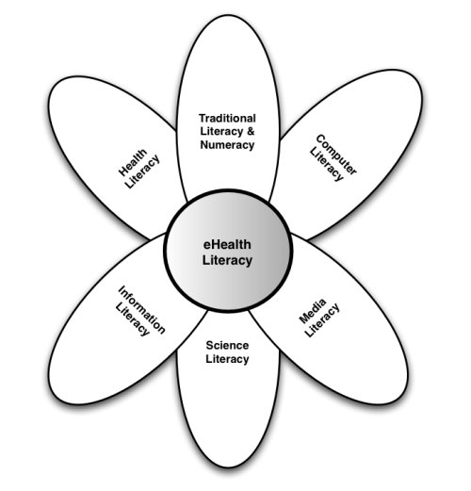
Building eHealth literacy - The Lily Model
In the modern context of digital health literacy, computer literacy means an ability to effectively engage with digital health technologies (EHR, EMR’s.)
Hence: Technical skills are key to using your systems.
Threats
1. Ransomware attacks
2. Cloud exploitations (~95% increase from 2021)
3. Phishing
4. Software and zero-day vulnerabilities
5. Distributed Denial of Service attacks (DDoS)
The Lily Model - eHealth Literacy: Essential Skills for Consumer Health in a Networked World, 2006
Notes:
Within the lily model, the six literacies are organised into two central types: analytic (traditional, media, information) and context-specific (computer, scientific, health).

Slide 37
Clinical Examples
Notes:
How the user who is not sophisticated engages with the technology
The naivety of the the patients (older patients, younger patients)
Healthcare workers understanding and building on that understanding and risks and breaches around this…Brad clinical examples

Slide 38
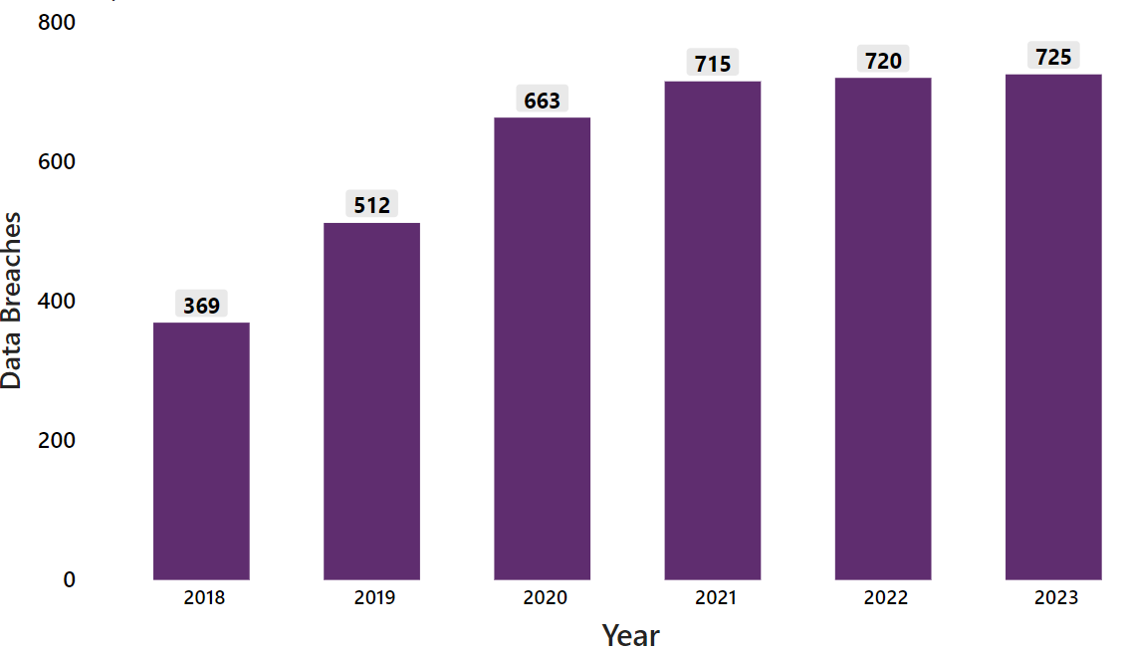
Healthcare data breaches
“threats to healthcare organisations are steadily growing”
- Forbes, 2021
More systems
Valuable
Expensive management
Healthcare security data breaches
of 500+ records (2018-2023)
Biggest Healthcare Security Breaches in 2023
Entity | Source of threats | People affected | Cause of Data Breach
Healthcare Provider | *BA | ~11.3m | Network access - hackers
Transcription service provider | *BA | ~9m | Network access - hackers
Insurer | *BA | ~8.9m | Ransomware
Healthcare software company | *BA | ~8.5m | Network access - hackers
Pharmacy group | Provider | ~5.8m | Ransomware
HIPAA: 2023 Healthcare Data Breach Report
*BA - Business Associate (e.g.Microsoft, Telehealth platforms , Cloud providers - AWS, Azure)
Notes:
People often the source of data breach. Remember the 3 p’s: People affected: source of vulnerability is internal staff…lack of skilled individual, lack of consistency with maturity assessment…

Slide 39
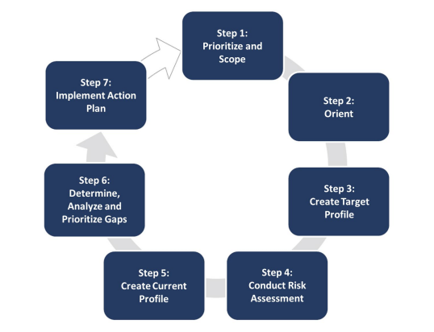
Cybersecurity resilience resources
Healthcare Sector Cybersecurity Framework Implementation Guide - HICP
The Framework for Improving Critical Infrastructure Cybersecurity Framework - NIST
Significant Progress Made
Email protection systems
Urgent Improvement Needed
Endpoint protection systems Identity and access management Network management Vulnerability management Security operation center and incident response
Further Attention Required (Not Urgent)
Data protection and loss prevention
Additional Research Required
IT asset management Network connected medical device security Cybersecurity oversight & governance
Notes:
Directed towards how to assist small organisations…assumption is that bigger organisations know how to protect themselves but for the smaller guys, there are resiliency resources and frameworks that can assist strengthening of resiliency…NIST 7 step resiliency plan….supports continuous and consistent training of staff and self assessment of maturity….Must

Slide 40
Cybersecurity resilience in different sized organisations
Smaller, resource-constrained organisations do not have the same capability as medium and large enterprises - HICP implementation guide, 2023
Small organisations
Large and Medium sized organisations
IT capability | No dedicated IT professionals | Dedicated internal IT resources with budget/ co-management or fully outsourced IT capability
Cybersecurity investment | None or limited funding | Allocated funding for specific cybersecurity projects with strategic roadmaps
Top cybersecurity threats
Social engineering
Ransomware attack
Loss or theft of equipment or data
Insider, accidental or malicious data loss
Network connected medical devices
Hospital Cyber Resiliency Landscape Analysis, 2023, HICP Implementation guide , Small Organisations Guide , Large Organisations guide
Notes:
What does this look like across small and large organisations……expensive and time

Slide 41
Cybersecurity resilience focus areas for small organisations
Cybersecurity practice | Cybersecurity sub-practice
Email protection systems | Email system configuration Education Phishing simulations
Identity and access management | Basic access management
Data protection and loss prevention | Policies Procedures Education
Incident response | Incident response Information sharing
Cybersecurity oversight and governance | Policies Cybersecurity risk assessment and management Security awareness and training Cyber insurance
Non-exhaustive, comprehensive practices can be found in the: Technical Volume 1: Cybersecurity Practices for Small Healthcare Organizations
Notes:
Practices that organisations that setup for cyber resiliency…non-exhaustive, can mention others to create awareness….Can open to the audience….

Slide 42
Scenario 2 | Digital health literacy
John
John’s primary care physician is Dr. Ramos
Dr. Ramos
Outside of work, Dr. Ramos is a pet lover and has a strong love for his dog, Fluffy.
Dr. Ramos set his password as Fluffy-123 on Triangle EHR because it's easy to remember.
Dr. Ramos entered Fluffy into a dog competition hosted by PawPaw Events in June 2024. He sent the application form using his work address to infoComp@paw.com.
A week later he receives a congratulatory response from PawPaw (infoComp@pavv.com) via his work email with a link to the payment site which he follows.

Slide 43
Scenario 2 | Maturity Self-Rating
Self-Assessment
What cyber resilience risks can you identify from this scenario?
How do you think the risks identified in this scenario may be related to the previous scenario?
Depending on your chosen model, how would you rate the maturity of your organisation’s digital health literacy and its ability to protect itself from some of the risks in the scenario ?

Slide 44
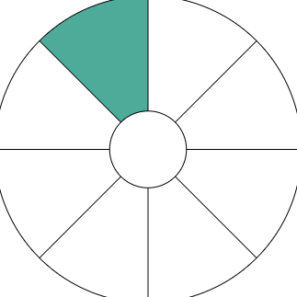
eHealth governance
Notes:
Reference
Image

Slide 45
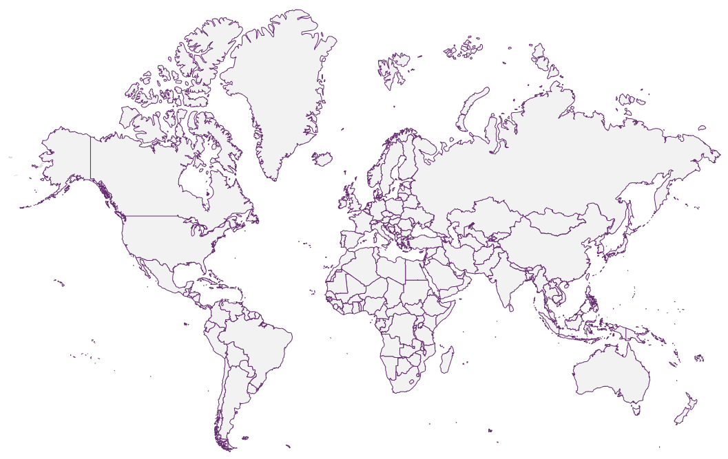
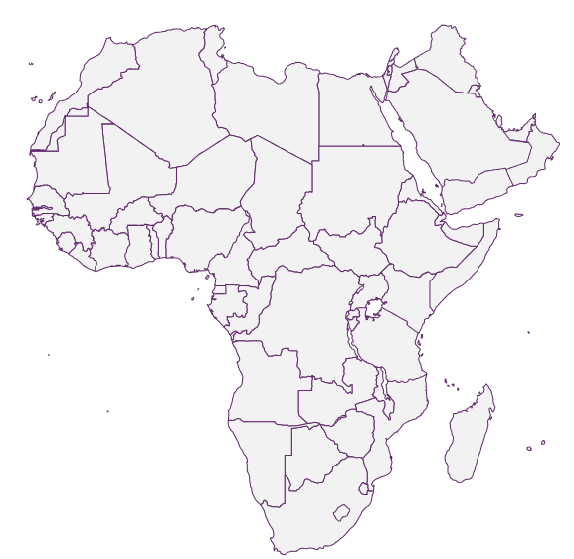
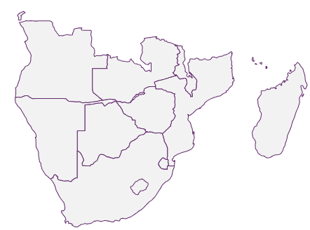
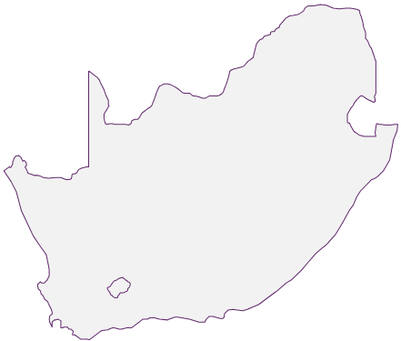
The legal landscape and eHealth governance
Non-exhaustive list
World Health Organisation (WHO), NIST Cybersecurity Framework
Google
Amazon Web Services (AWS)
Apple
Microsoft cybersecurity policy framework
Global
Continental
Africa Agenda for Cyber Capacity Building
Computer Fraud and Abuse Act (USA)
EU AI Act
European Union Agency for Cybersecurity - EU
Regional
[Text]
General Data Protection Regulation (GDPR) - EU
EU Cybersecurity Act
African Union Convention on Cybersecurity and Personal Data Protection
CyberBRICS
Neighbouring
[Text]
Most important
Local National Cybersecurity Policy Framework
HIPAA (USA), PIPEDA (CAN), POPIA (RSA)
Essential Eight (AUS)
21st Century Cures Act (USA)
[Text]
Domestic

Slide 46
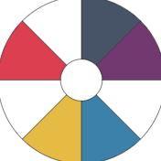
EHR, Telemedicine and mHealth environment
Enabling Environment
Non-exhaustive
Varied Data Protection Acts/Bills, Ministries of Health
Patient Data
Privacy
Security
Domestic
Regional
Global
LGPD
POPIA
African Union
Global Data Alliance (GDA)
HIPAA
Federal Law No 2 of 2019
APEC-CBPR
WHO
GDPR
APPI
Global Alliance for Genomics and Health
Notes:
Not just platforms…regulations and policies in place….Ask the audience: Are you aware of compliance and reg frameworks that govern you domestically…. And when engaging and sharing data globally……
The important of the enabling environment….Breaking it down from a different perspective to understand the patient data journey and the domestic vs the international digital health data use and journey…Be alert to fines, liabilities if compliance is not adhered to…eg. Telemedicine vs telehealth legislation and guidelines and use across countries and regions vary…breaches and compliance eg. EU examples (EU to EU) but EU to USA?
Data: What happens when you have medical tourism - Who’s territory standard do we use - Jurisdiction consideration of record ownership as well as record keeping, liability questions (If I consult with a patient in country X what happens)
References
Brazil, LGPD and GDPR
Brazil regulation
UAE
African Union Convention on Cybersecurity and Personal Data Protection
POPIA
APEC Cross-Border Privacy Rules (CBPR)
Global data alliance
Global Alliance for Genomics and Health (GA4GE)
mApps in Africa
Data Sharing in Africa
Act on the Protection of Personal Information (APPI) - Japan

Slide 47
5 min Break

Slide 48
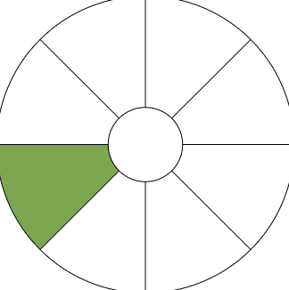
Standards and Interoperability
Notes:
Reference
Image

Slide 49
The healthcare data life cycle
Patient-Provider interactions
Wearable/Smart devices
Patient self-reported
Healthcare providers
Insurance companies
Research institutions
Clinical decisions
Health policies
Patient care
Creation
Storage
Exchange
Analysis
Usage
Disposal
Electronic Health Records (EHRs)
Databases
Health information systems
Improving patient care
Research
Machine Learning
Regulatory right to erasure
Request for deletion of personal data
Continua Design Guidelines (CDG)
Application Program Interface (API)
Fast Healthcare Interoperability Resources (HL7 - FHIR)
21st Century Cures Act (2016)
Integrating Healthcare Enterprise (IHE)
Healthcare Information and Management Systems Society (HIMSS)
Notes:
FHIR - universal health data translation vs API (varies across platforms). Disposal is not assumed

Slide 50
Where is the biggest vulnerability along the health data path ?
Creation
Storage
Exchange
Analysis
Usage
Disposal
Notes:
Ureshnie notes: recall the importance of guidelines that are there to protect the data and all stakeholders the threats that exist throughout the healthcare data journey in the ecosystem

Slide 51
Where is the biggest vulnerability along the health data path ?
Notes:
Ureshnie notes: recall the importance of guidelines that are there to protect the data and all stakeholders the threats that exist throughout the healthcare data journey in the ecosystem

Slide 52
Standards and interoperability
Standards
“The set of rules and specifications for exchanging healthcare information electronically”
FHIR, 2023
Interoperability
The ability for different users to access the same data regardless of the system or device they are using - FHIR, 2023
“The ability of two or more systems or components, to exchange information and to make mutual use of the information that has been exchanged” - ENISA 2022
Notes:
. An interoperable digital health ecosystem should enable the seamless and secure exchange of health data by and between users, health care providers, health systems managers, and health data services. Health data are predominantly generated by and processed between health care providers and the health care community. Sharing health data in the context of a person-centric digital health ecosystem and for the purpose of public interest should be encouraged with the patient’s consent, when undertaken in a manner that is built on trust, protects patient privacy, secures digital systems, and protects against malign or inappropriate use. . Such sharing is vital as it can contribute to the enhancement of quality of processes, the outcomes of health services and the continuity of care for patients (primary use of health data). - WHO Digital Health Strategy
References
FHIR Standard
FHIR Standard
ENISA Interoperability

Slide 53
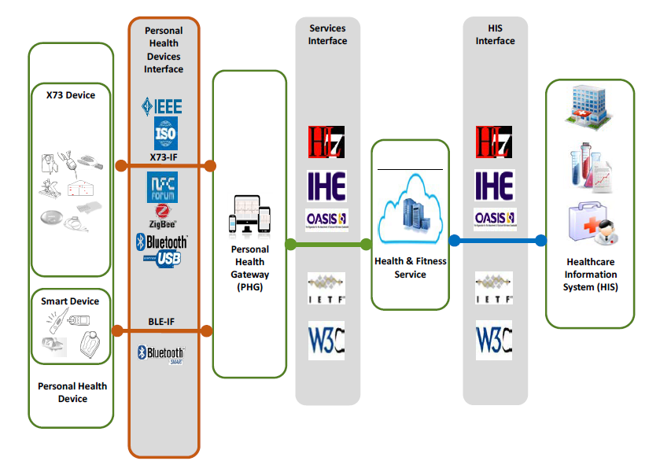
Fast Healthcare Interoperability Resources (FHIR) - an example
FHIR is a “universal translator” of health data
The connectivity and interfaces between personal health devices, services, and health information systems
Notes:
https://www.youtube.com/watch?v=YbQcJj1GqH0&pp=ygUERkhJUg%3D%3D
Image shows the flow of data - The increasing demand for accurate and efficient healthcare services highlights the importance of effective communication among diverse healthcare systems. Interoperability plays a critical role in delivering coordinated
patient care, enabling data sharing, and supporting informed decision-making processes.
References
66% FHIR API use in USA
API in Access
KEY PRIVACY AND SECURITY CONSIDERATIONS FOR HEALTHCARE APPLICATION PROGRAMMING INTERFACES (APIS)
By providing a flexible, extensible, and resource based standard, FHIR enables the seamless exchange of health- care information, which is crucial for delivering coordinated patient care, improving clinical decision-making, and reducing healthcare costs.
USA
In the USA - More than two-thirds of hospitals reported using a HL7® Fast Healthcare Interoperability Resource (FHIR®) API to enable patient access to data in 2022
Four in five hospitals used APIs to enable apps to write data to the EHR and read EHR data, respectively
HL7 is a not-for-profit, ANSI-accredited standards developing organization dedicated to providing a comprehensive framework and related standards for the exchange, integration, sharing, and retrieval of electronic health information that supports clinical practice and the management, delivery and evaluation of health services
ANSI accreditation refers to the recognition given by the American Natio nal Standards Institute (ANSI) to standards developers that adhere to ANSI’s requirements and oversight
The FHIR defines the “standards for healthcare data exchange, including how healthcare information can be shared between different computer systems regardless of the way it is stored”
FHIR makes it simple for patients to manage their care, even if they see multiple providers in different healthcare organizations and use multiple plans (multiple payers using multiple EHRs). By creating a unified, single personal patient health record that integrates data from different formats
FHIR standards deliver a complete view of patient information to improve overall care coordination and clinical decision support.
FHIR describes
Data elements,
Messaging and document formats
Application programming interface (API) for exchanging electronic health records (EHRs) and electronic medical records (EMRs).
Other considerations
FHIR allows the developers to develop standardized browser applications that enable the user to access clinical data from any health care system regardless of the operating systems and devices that a health care system uses - https://www.ncbi.nlm.nih.gov/pmc/articles/PMC8367140/
With regard to health research, there is still a lack of use of international standards when exchanging data between healthcare and research institutions - https://www.ncbi.nlm.nih.gov/pmc/articles/PMC9346559/

Slide 54
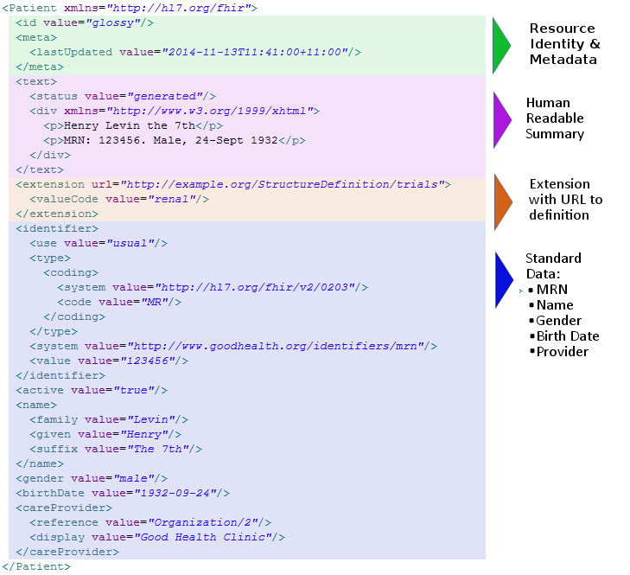
Healthcare data
Patient “Resource” or “Code”
What does patient data look like ?
FHIR, 2023
Notes:
Make it cool- around the tech. Message: What you see on the screen is not the output you receive from products. The code is the key information that is translated for the output received.
References
Interoperability challenges
FHIR Resource
Resources
Resources have a common way to define and represent them, a common set of metadata, and a human-readable part
Profiles, conversely, describe specific use cases and constraints on resources, ensuring that data exchanged between different systems remains consistent and accurate
Resource: Identity and Metadata: This refers to the unique identifiers and additional information that describe a resource. Identity could be a unique ID assigned to the resource, while metadata provides more context about the resource, such as its creation date, author, or source.
Human Readable Summary: This is a brief, easy-to-understand description or overview of the resource. It is designed to be easily read and understood by a human, as opposed to machine-readable code or data.
Extension with URL to Definition: This is a link (URL) to a detailed definition or description of the resource. The extension could provide additional information or functionality related to the resource.
Standard Data (MRN, Name, Gender, Birthdate, Provider): This refers to the standardized information or data fields associated with the resource. In this case, the standard data includes:
MRN (Medical Record Number): A unique number that identifies a patient’s medical record.
Name: The name of the patient.
Gender: The gender of the patient.
Birthdate: The birthdate of the patient.
Provider: The healthcare provider or institution that is responsible for the patient’s care.
These components together provide a comprehensive view of the resource, making it easier to understand and use the resource effectively.
Resources, the fundamental building blocks of FHIR, represent individual data elements such as patients practitioners, or medication
Thus, a resource is a known identity providing meaningful data
FHIR has resources for administrative concepts such as patient, provider, organization and device as well as a wide variety of clinical concepts covering problems, medications, diagnostics, care plans, financial concerns and more.

Slide 55
Scenario 3 | Governance and interoperability
Loda Republica (Non-EU)
Castle Republica (EU)
Dr. Shari
1
The BLUE Hospital
The RED Hospital
Dr. Shari has recently moved from The BLUE Hospital in Loda Republica (Non-EU) to The RED Hospital in Castle Republica (EU).
Dr. Shari is a Cardiologist. Part of her reason for moving was to support an ongoing clinical trial at the RED Hospital in Castle Republica (EU) for the development of a new anticoagulant.
She remembers that in The BLUE Hospital, there was a patient who had some data that would be beneficial for the research team at the RED Hospital in Castle Republica (EU).
Using her old credentials, She accesses the EHR system at The BLUE Hospital. She downloads the patient’s file and shares it with the research team at the RED Hospital in Castle Republica (EU) via email.

Slide 56
Scenario 3 | Maturity self-rating
Self-assessment
What cyber resilience risks can you identify from this scenario?
How could a robust understanding of eHealth governance, cybersecurity, cyber resilience and interoperability prevent some of these risks?
Depending on your chosen model how would you rate your organisation’s maturity considering your understanding of eHealth governance across different regions and interoperability in exchanging data ?

Slide 57
15 min Break

Slide 58
3
The operating environment

Slide 59
1
The Fundamentals of data security in healthcare
Introduction Audience asked to map out their thoughts of of the digital journey within the digital ecosystem The digital health journey Overview of the digital health journey and where in the digital health journey different parts of the digital ecosystem are found. Telemedicine vs Telehealth The importance understanding differences in the definition of Telemedicine and Telehealth Electronic Health Records, mHealth, Social Media Address the digital operating environment and accompanying definitions Information sharing standards in the digital operating environment Emerging technologies Address the evolving digital ecosystem Interactive session - Scenario 4: John’s data journey and maturity self-rating scenario
2
Regulations and guidelines in the Digital Health Ecosystem
3
The operating environment
4
Regulatory requirements for healthcare data
5
Guidelines and principles for data compliance and protection in operations
6
Practical applications and examples for health data security

Slide 60
Healthcare data

Slide 61
What do you think the digital health journey looks like in the digital health ecosystem ?

Slide 62
The digital health journey
Enabling environment
Information seeking
Consultation
Treatment and medication
Post-consultation
Seeking information
Profile creation
Fulfillments
Compliance
Internet
GenAI, LLM
Health Tracking Apps
Social media
Telehealth/
Telemedicine
Electronic medical records (EMR)
Electronic Health records (EHR)
Health information exchange platforms
Resources (Medscape)
Remote Care (Rehabilitation-Genie )
Hospital-at-Home
eScripts
mHealth - Apps & devices
Telehealth/Telemedicine (Follow-Up)
Social media
Patient support portals
Compliance apps
Outreach
Contact (proximity)
Online booking
Notes:
References
Digital tools in African Healthcare systems - Mckinsey
Enabling environment
Seeking information is the first segway into the digital ecosystem
80% of health-related consultations are carried out on Google or other search engines, and one in 20 searches on Google relates to health, In the US, 72% of adults active on the internet search for information about their health (60% in Europe). - Digital Health Ecosystem
Outreach is based on proximity, contact details, online and book appointment
HIS is a system that integrates data collection and the processing, reporting, and use of the information necessary for health systems to work better.
Different HISs:
District information system (to manage health service delivery data in a district),
Human resource information system (to manage health worker and health administrator data),
Logistics management information system (to manage supply chains), and a laboratory

Slide 63
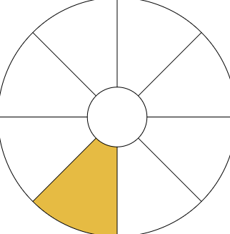
Telemedicine vs Telehealth
Telemedicine
“the provision of health services by health professionals, where distance is a critical factor, using information and communication technologies to exchange valid information for the purposes of diagnosis, treatment and prevention of disease and injury, research and evaluation, and to facilitate the continuing education of health professionals, with the aim of safeguarding the health of individuals and communities ” - WHO, 2021
Telehealth
“ the use of communications technologies to provide health care at a distance.”
- NCBI
Notes:
Reference:
Telemedicine definition
Telehealth differs from telemedicine because it encompasses a broader scope of remote healthcare services. Telemedicine refers specifically to remote clinical services. Telehealth, in addition to clinical services, includes remote non-clinical services, such as: Clinician training, Administrative meeting and Continuing medical education.
Telemedicine/Telehealth - is often interchangeable and thus pertinet to define it in your operational context

Slide 64
Health data in telemedicine
Telemedicine
healthcare data
Real time
Asynchronous
Four categories of telemedicine services:
Consultations between remote client and healthcare provider
Remote monitoring of client health or diagnostic data by a HCP
Transmission of medical data to a healthcare provider
Consultations for case management between healthcare providers
Privacy
Security
Domestic
Regional
Regulation and guidelines
Global
Notes:
Telemedicine refers specifically to interactive health communications with clinicians on both “ends” of the exchange. For example, telemedicine allows you to
Cybersecurity - Importance in both
References
Categories of Telehealth
Telehealth policy considerations

Slide 65
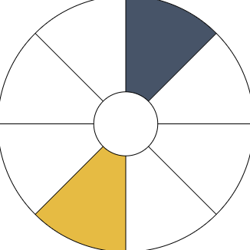
Telemedicine and mHealth applications
mHealth
“At the time, it was defined as the delivery of health care services through mobile communication devices” - Torgan, 2009
“The use of mobile and wireless communication technologies to improve healthcare delivery, outcomes, and research” - Singh, 2017
Telemedicine
mHealth
Platforms
Smartphone apps
Activity trackers
Automated reminders
Blood glucose monitors
Notes:
References
Singh 2017

Slide 66
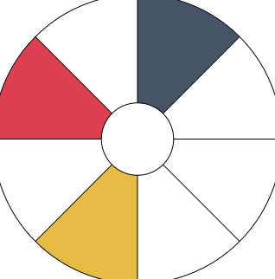
Creating John’s Electronic Health Record (EHR)
John
John has a wearable mHealth device, Rombus mHealth, to monitor his heart rate and blood pressure.
When an irregularity is detected, the device alerts his doctor, Dr. Ramos, who then schedules a virtual consultation via a telemedicine platform.
Integration and Coordination of Patient data
Enhanced Continuity of Care
Electronic Health Records (EHRs)
Notes:
The use of telemedicine requires that the health worker can access the patient’s relevant clinical history. Integration with digital health record systems that can be accessed by the health worker and in which the patient’s identity can be verified may be considered as a way to facilitate continuity of care.
EHRs consolidate all of John’s medical history, test results, prescribed treatments, and more, enabling healthcare providers to make informed decisions promptly. In the context of mHealth and Telemedicine, EHRs are not just beneficial; they are indispensable.
Self-awareness - mHealth
Early detect - follow John through and revisit later
Big data - begins to be important in EHR

Slide 67
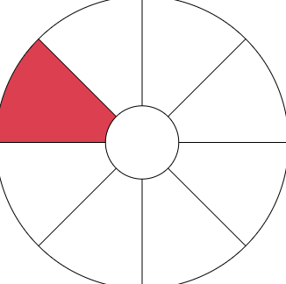
Definition of an Electronic Health Record
In many low- and middle-income countries, patient data is still stored on paper registers
and patient cards - World Bank,2023
Electronic Health Records
“a digital version of a patient’s paper chart. EHRs are real-time, patient-centered records that make information available instantly and securely to authorized users. Contain a patient’s medical history, diagnoses, medications, treatment plans, immunization dates, allergies, radiology images, and laboratory and test results”
Office of the National Coordinator for Health Information Technology (ONC)
“a collection of electronic health data related to a natural person and collected in the health system, processed for healthcare purposes”
The European Health Data Space (EHDS)
Notes:
References
EHR definition
EHR Security
As mentioned definitions are important because they may differ in different from different countries - you need to define what you mean by those words to protect yourself from the law
In the last 10 years, digital health record adoption has rapidly increased
EHR: are built to share information with other health care providers, such as laboratories and specialists, so they contain information from all the clinicians involved in the patient’s care.
Data quality issue -World Bank Reference
Digital discontinuity: If health records are paper-based or if digital health record systems are disconnected from each other, data need to be manually aggregated and collected from these separate sources. These periodic, non–real-time data collection efforts are at the root of most troublesome data quality issues .
Data at the source: E.g in patient medical records)are typically correct, complete, and captured when the service is delivered. If the data are not digitised at the source, they need to be collected later, usually through aggregate reporting forms. This results in weak data quality and use.

Slide 68
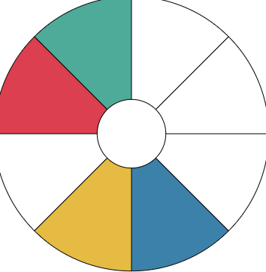
Stakeholders in the digital health ecosystem
“Potential barriers behind the comparatively low adoption rate of electronic medical records by physicians include privacy and security concerns, high start-up costs, workflow changes, system complexity, lack of reliability, and challenges with interoperability” - Dutta and Hwang (2020)
Stakeholders
Patients, community members
Healthcare providers/staff
Regulatory agencies
Health IT vendors/ wearables/ mApps
Funders/payors
Biomedical & life sciences
Academic institutions
Pharma/clinical trial researchers
Interoperability
Data at the source: Minimised digital discontinuity to limit manual aggregation
Notes:
Reference
World Bank Reference
EHRs - Once we move we can see other parts getting involved
EHR: EHRs can quantify disease burdens and track health trends. facilitates information sharing across organizations. uantify disease burdens and track health trends.
EHR: are built to share information with other health care providers, such as laboratories and specialists, so they contain information from all the clinicians involved in the patient’s care.
Standard and regulation and big Data -
Each regulation has its own specific requirements that need to be met. It’s important to note that compliance with HIPAA does not automatically imply compliance with GDPR, and vice versa
4 domains of interoperability:
Find,
Send
Receive
Integrate electronic health information with sources outside their health system.
Challenges with interoperability
Health information systems are also fragmented and disconnected with separate unlinked digital health record systems often existing for the same persons at different timepoints and for different health services; for example, their pregnancy data, malaria data, and vaccination data stored in different places and at different times.
Stakeholders
Walmart and Santander and Discovery
Patients: Owners of their health data.
Healthcare Providers: Responsible for EHR management.
Regulatory Agencies: Enforce privacy regulations.
Health IT Vendors: Develop and maintain EHR systems
Payors:
Biomedical (genetics, Biobank, epigenetics)
Academics institutions
Clinical trial researchers
Wearables (garmin, fitbit, apple)
Regulation of Data in Africa
Utilisation in Asia
POPI and Medical Records
Effects of a cyber breach
Complying with GDPR and HIPAA

Slide 69
EHR, Telemedicine and mHealth environment
Enabling Environment
Non-exhaustive
Varied Data Protection Acts/Bills, Ministries of Health
Patient data
Privacy
Security
Domestic
Regional
Global
LGPD
POPIA
African Union
Global Data Alliance (GDA)
HIPAA
Federal Law No 2 of 2019
APEC-CBPR
WHO
GDPR
APPI
Global Alliance for Genomics
and Health
Notes:
The important of the enabling environment - reiterating the point to create privacy and security of patients data…understand governance and how it applies across countries, regions, globally, platforms…hence compliance and cyber-security
Data: What happens when you have medical tourism - Who’s territory standard do we use - Jurisdiction consideration of record ownership as well as record keeping, liability questions (If I consult with a patient in country X what happens)
References
Brazil, LGPD and GDPR
Brazil regulation
UAE
African Union Convention on Cybersecurity and Personal Data Protection
POPIA
APEC Cross-Border Privacy Rules (CBPR)
Global data alliance
Global Alliance for Genomics and Health (GA4GE)
mApps in Africa
Data Sharing in Africa
Act on the Protection of Personal Information (APPI) - Japan

Slide 70
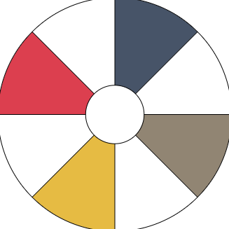
Considerations when selecting a digital service provider/vendor
Is the product/provider compliant ?
e.g Certified Health IT Product List - HIPAA
Does it integrate into my existing digital ecosystem ?
e.g. EHR platform - Cross-system interoperability
e.g. Multiple user function - specialty consultant
What is the patient/staff usability ?
e.g. Upskilling required (compliance - cybersecurity risk)
e.g. Level of customisation
e.g. Patient consent - Telehealth consultation
What are the costs to patients/users ?
e.g Demonstrate ROI
e.g. Quality Payment Program (QPP)
Are there any inherent cybersecurity features ?
e.g. Data encryption
e.g. User authentication and authorizations
What are the limitations of the plattform ?
e.g. Number of users/accounts
e.g. Data analysis
Are there case studies/testimonials ?
e.g. Peer-reviewed literature/ clinical evidence
“private sector in multiple markets is now rapidly adopting digital health. There is also now significant interest and early adoption in many emerging markets”
World Bank, 2023
Notes:
eLiteracy: Clinical staff all need literacy ….maintain security…here are points to be aware of as digital services can expose one and an organisation if cyber-security and resilience are not in place….be aware of the regulations as per region and integration in the eco-system
Reference
World Bank Reference
Choosing a telehealth vendor
Selecting a vendor

Slide 71
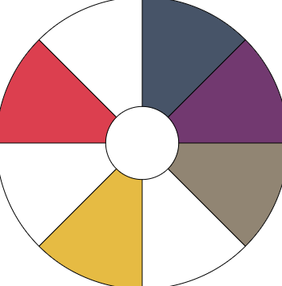
Social media
“The usage of social media platforms in digital healthcare ecosystem is not desirable. Healthcare practitioners are advised not to interact with patients via social media platforms as a failure to maintain strictly professional relationships with patients could result in ethical dilemmas”
Patient-professional relationship
Trust
Notes:
Patient-professional relationship: Trust - Information shared in confidence for the purpose of healthcare ought to be protected, because failure to do so violates the patient's rights and undermines the patient-professional fiduciary relationship
Another area of concern is dissemination of patients' pictures on social media that might constitute invasion of privacy, defined as a situation in which someone fails to respect a person's right to keep certain personal information from being known.^{[15]} This could be for information sharing, educational purposes, or other reasons. Professionals are also warned against taking pictures without obtaining signed informed consent from their patients, especially if the patient is identifiable.^{[2]} Patients ought to explicitly give informed consent for the taking of pictures and for the dissemination of their pictures on any media platform.
References:
Social Media for Healthcare Professionals
Social Media
Other guidance:
HIPAA - Ensure that PHI shared on social media platforms complies with HIPAA regulations and does not violate patient privacy rights
WHO - “Importance of professionalism, patient privacy, and data security.,Recommends de-identification, anonymisation and clear policies and procedures for the use of social media in healthcare settings”
POPIA - Personal information, including health information, shared on social media platforms must be protected against unauthorized access or disclosure
GDPR - Data subjects must provide explicit consent for the processing of their personal data on social media, and controllers must implement appropriate security measures to protect data privacy

Slide 72
The future of the digital ecosystem
What does cyber resilience look like in digital ecosystem of the future?

Slide 73
Establishing a digital ecosystem
Global and regional partnerships
Digital skills and literacy
Finance incrementally
Focus first on interoperability
standards and certification
People-centered
Data governance
Solutions that prioritise
marginalised groups
Notes:
Whatever the future context my look like, certain aspects will always remain important
Reference
World Bank Reference
We’ll refer to this later in slide 90

Slide 74
Scenario 4 | Social Media, EHR, Telemedicine, mHealth
John
1
Dr. Ramos
The RED Hospital
2
Second opinion
Alert
2a
3
Consultation
Dr. Ramos sees a concerning alert from John’s Rombus mHealth app and immediately books a telehealth consultation with John.
The doctors at The RED Hospital have a local whatsapp group where they share information.
Dr. Ramos sent a alert picture of the notification to the group for a second opinion.
On of his colleagues (Dr. Shari) immediately responds confirmingDr. Ramos’ thoughts.
Dr. Ramos proceeds with the consultation.
All information from the consultation is loaded onto John’s EHR.
3a
EHR
2b
Recording

Slide 75
Scenario 4 | Maturity self-rating
Self-assessment
What cyber resilience risks can you identify from this scenario?
Are there any potential legal violations in the scenario?
Depending on your chosen model, rate your maturity level when operating in the digital health ecosystem?
Consider aspects such as:
Risk Assessment
Security
Privacy

Slide 76
Close of Day 1 - Feedback, Q&A session
Notes:
Menti
How many are using which one ?
Where are they on their own scale ?

