Slide 1

In partnership with the Government of Japan
DRAFT - Healthcare Data Protection – Policies, Protocols, and Practices
Day 2
epihc.org

Slide 2


Day 2 - Welcome

Slide 3






Speakers - Day 1 & Day 2
Facilitators
Dr. Ureshnie Govender
Dr. Sana Charania
Malvin Tshabalala
Workshop Subject Matter Experts
Dr. Prinesh Reddy
Dr. Brad Beira

Slide 4






Recap from Day 1 and preparation for Day 2
1
The fundamentals of data security in healthcare
2
Regulations and guidelines in the digital health ecosystem
Day 1
3
The operating environment
4
Regulatory requirements for healthcare data
5
Guidelines and principles for data compliance and protection in operations
Day 2
6
Practical applications and examples for health data security

Slide 5
Reminder: The P’s to remember
Safeguarding information & data security
The users of the platforms in the ecosystem.
The technology used in the ecosystem.
People
Process
Platform
How the users interact in the ecosystem.

Slide 6


John’s data journey and maturity self-assessment
Throughout the workshop we will be following “John”
Johan is a patient who is in the healthcare ecosystem and is navigating different scenarios that expose his data to different security risks.
Additionally, after every section, the audience will be asked to self-assess their maturity
Aim: After the workshop the audience will have a holistic view of their cybersecurity maturity across different elements of the digital health ecosystem.

Slide 7

4
Regulatory requirements for healthcare data

Slide 8






1
The Fundamentals of data security in healthcare
Data collection and processing Interactive session - Scenario 5: John’s data journey and maturity self-rating scenario Considerations for healthcare data collection & processing Healthcare data access deep dive Interactive session - Scenario 6: John’s data journey and maturity self-rating scenario Considerations for healthcare data access Healthcare data protection deep dive Interactive session - Scenario 7: John’s data journey and maturity self-rating scenario Considerations in healthcare data protection
2
Regulations and guidelines in the Digital Health Ecosystem
3
The operating environment
4
Regulatory requirements for healthcare data
5
Guidelines and principles for data compliance and protection in operations
6
Practical applications and examples for health data security

Slide 9
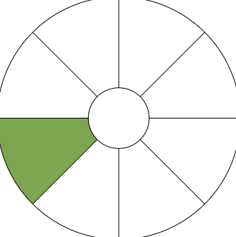
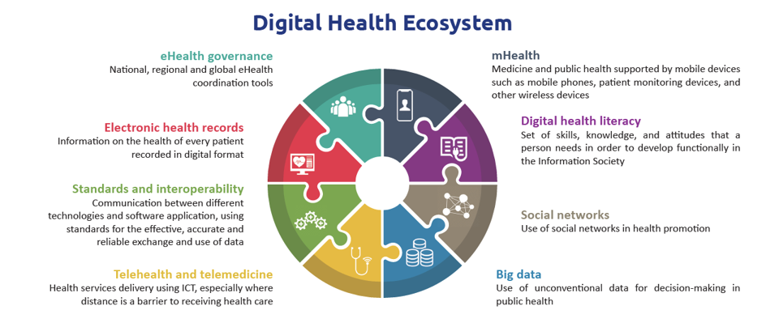
Healthcare data

Slide 10
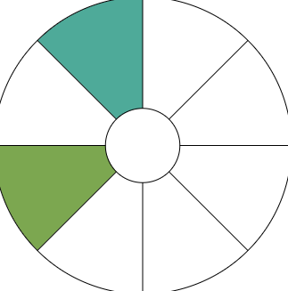

Healthcare data collection - GDPR definitions
General Data Protection Regulation (GDPR)
“Any information relating to an identified or identifiable natural person. Identifier such as a name, an identification number, location data, an online identifier or to one or more factors specific to the physical, physiological, genetic, mental, economic, cultural or social identity of that natural person” - Article. 4 GDPR, (1)
Notes:
Remind the defn of healthcare data - for the rest of the day we will discuss data security but GDPR will be our source….
Reason: comprehensive and EU standard
GDPR - working reference for the rest of the day….wider in scope than HIPA, POPIA is SA but GDPR is widely applicable
GPR is the main source- comprehensive
References
GDPR Articles GDPR
GDPR stands for General Data Protection Legislation. It is a European Union (EU) law that came into effect on 25th May 2018. GDPR governs the way in which we can use, process, and store personal data (information about an identifiable, living person).
the toughest privacy and security law in the world. Though it was drafted and passed by the European Union (EU), it imposes obligations onto organizations anywhere, so long as they target or collect data related to people in the EU. The regulation was put into effect on May 25, 2018. The GDPR will levy harsh fines against those who violate its privacy and security standards, with penalties reaching into the tens of millions of euros.
With the GDPR, Europe is signaling its firm stance on data privacy and security at a time when more people are entrusting their personal data with cloud services and breaches are a daily occurrence. The regulation itself is large, far-reaching, and fairly light on specifics, making GDPR compliance a daunting prospect, particularly for small and medium-sized enterprises (SMEs).
The right to privacy is part of the 1950 European Convention on Human Rights, which states, “Everyone has the right to respect for his private and family life, his home and his correspondence.” From this basis, the European Union has sought to ensure the protection of this right through legislation.

Slide 11

Collection/Processing

Slide 12
Healthcare data collection definitions
General Data Protection Regulation (GDPR) Article 5, 6, 30
Processing
“Any operation or set of operations which is performed on personal data or on sets of personal data, whether or not by automated means, such as collection, recording, organisation, structuring, storage, adaptation or alteration, retrieval, consultation, use, disclosure by transmission, dissemination or otherwise making available, alignment or combination, restriction, erasure or destruction”
Controller
“Natural or legal person, public authority, agency or other body which, alone or jointly with others, determines the purposes and means of the processing of personal data; where the purposes and means of such processing are determined by Union or Member State law, the controller or the specific criteria for its nomination may be provided for by Union or Member State law”
Consent
“of the data subject means any freely given, specific, informed and unambiguous indication of the data subject’s wishes by which he or she, by a statement or by a clear affirmative action, signifies agreement to the processing of personal data relating to him or her”
Notes:
Principles relating to processing of personal data are clear under the regulation- from processing, accountability (controller) and importance of consent. Laws that clearly define when processing is permitted and how the controller is responsible for maintaining record- 1Each controller and, where applicable, the controller’s representative, shall maintain a record of processing activities under its responsibility.
Legal bases for processing patient data under GDPR
To process patient data under GDPR, healthcare organisations must establish a legal basis for processing. The legal bases include:
Consent: Obtaining explicit and informed consent from patients for specific processing activities.
Contractual necessity: Processing data that is necessary for the performance of a contract with the patient, such as providing healthcare services.
Legal obligation: Processing data to fulfill legal obligations imposed on the healthcare organisation.
Vital interests: Processing data to protect the vital interests of the patient or another individual.
Legitimate interests: Processing data based on legitimate interests pursued by the healthcare organisation, provided that the interests do not override the rights and freedoms of the individual.
Data Collection
Key is Communication
Communicating to participants clearly and conspicuously concerning: how, when, and what information will be collected and stored; to explain how health information about them will be used, accessed, and shared; and the goals, potential benefits, and risks of participation
Give individuals clear notice regarding why health information about them is collected, how it is used, and to whom it might be disclosed via a notice of privacy practices.
Third-Parties
Any language provided to an individual that describes the legal mechanism for enabling sharing of health information should be similarly transparent. - For example, under the HIPAA right of access, the individual’s request to direct health information to a third-party must be in writing, signed by the individual, and clearly identify the designated person or entity, of the individual’s choice, on where to send the health information
Data minimisation
Adequate, relevant and limited to what is necessary in relation to the purposes for which they are processed (‘data minimisation’);
Data quality and integrity
accurate and, where necessary, kept up to date; every reasonable step must be taken to ensure that personal data that are inaccurate, having regard to the purposes for which they are processed, are erased or rectified without delay

Slide 13
Healthcare data collection & processing
GDPR - Article 4, 5, 6
Processing
Vital interests
Lawfulness, Fairness and Transparency.
Processed in a manner that ensures appropriate security.
Confidentiality.
Protect an interest which is essential for the life of the data subject or another natural person.
Preventing fraud.
Purpose limitation
Consent
Collection
Specified, explicit and legitimate purposes.
Not processed in a manner that is incompatible with those purposes.
Given by data subjects for one or more specific purposes.
Make data subjects are aware of their rights
Withdrawal of consent at any time.
Data minimisation
Accuracy
Adequate, relevant and limited to what is necessary in relation to the purpose for which data is being processed.
Accurate, kept up to date.
Inaccurate data to be erased or rectified without delay timeously.
Notes:
Lawful processing and accountability on that- collect what is necessary, e.g. COVID pandemic and data publication
Limiting the purpose/ scoping-Personal data should be collected for specified, explicit, and legitimate purposes and not further processed in a manner incompatible with those purposes.
Data minimisation- Only the necessary and relevant personal data should be collected and processed, reducing the risk of data exposure and ensuring privacy.
Accuracy: Personal data should be accurate, up to date, and, if necessary, corrected or erased without delay.
Storage limitation: Personal data should be kept in a form that allows identification for no longer than necessary for the purposes for which it is processed.
Integrity and confidentiality: Appropriate security measures must be in place to protect personal data from unauthorised access, alteration, disclosure, or destruction.
References
Consent
Purpose Limitation

Slide 14
Healthcare data collection & processing
GDPR - Article 13
GDPR - Article 13
Information collected from the data subject
Information not collected from the data subject
Identity and Details of the controller
Details of the data protection officer
Purposes of the processing
Processing location
The recipients or categories of recipients
Any intention of the controller transfer data
Storage period
Data subject Rights (rectify, notification)
Inform data subject within a reasonable period - One month
Categories of personal data concerned
Source the personal data
Notes:
Rights of the subject. Information to be provided where personal data are collected from the data subject- communication. Needs to be fair and transparent processing
References
From data subject
The identity and the contact details of the controller
The contact details of the data protection officer
Purposes of the processing
Where the processing is based
The recipients or categories of recipients
Any intention of the controller transfer personal data to a third country or international organisation
Period for which the personal data will be stored
Right to lodge a complaint with a supervisory authority
Further process - Inform data subject prior to prior to that further processing
Not from data subject , Recital 61
Inform data subject with within a reasonable period after obtaining the personal data - within one month
Categories of personal data concerned
Source the personal data

Slide 15
Healthcare data collection & processing
GDPR - Article 4, 5, 6, 9
Processing of special categories of personal data
“Prohibited to process any personal data revealing racial or ethnic origin, political opinions, religious or philosophical beliefs, or trade union membership, and the processing of genetic data, biometric data for the purpose of uniquely identifying a natural person, data concerning health or data concerning a natural person’s sex life or sexual orientation”
Derogating Exceptions: Allowed by Union or Member State law
  Data subject has given explicit consent
  Vital Interests - Data subject or of another natural person
  Exercise or defence of legal claims
  Reasons of substantial public interest - public health
  archiving purposes in the public interest - Science research, Statistical purposes
Notes:
Laws that can overtake the controller? Added risk for special data
Union Law: This encompasses the treaties, regulations, directives, and decisions that constitute the body of laws applicable within the jurisdiction of the EU. It is binding on all Member States.
Member State Law: Each Member State of the EU has its own law and legal system. This can include national law, which is valid anywhere in a certain Member State, and laws which are only applicable in a certain area, region, or city within that Member State.
Data concerning health: personal data related to the physical or mental health of a natural person, including the provision of health care services, which reveal information about his or her health status
Biometric data: means personal data resulting from specific technical processing relating to the physical, physiological or behavioural characteristics of a natural person, which allow or confirm the unique identification of that natural person, such as facial images or dactyloscopic data;
Genetic data: should be defined as personal data relating to the inherited or acquired genetic characteristics of a natural person which result from the analysis of a biological sample from the natural person in question, in particular chromosomal, deoxyribonucleic acid (DNA) or ribonucleic acid (RNA) analysis, or from the analysis of another element enabling equivalent information to be obtained.
Why is this data special ? - Why is the data special
This data could create significant risks to the individual’s fundamental rights and freedoms
freedom of thought, conscience and religion;
freedom of expression;
freedom of assembly and association;
the right to bodily integrity;
the right to respect for private and family life; or
freedom from discrimination
When Using Special personal data - Special Data
Undertaking a data protection impact assessment - this is required for any type of processing which is likely to be “high risk”,
Ensuring the appropriate level of security is in place,
Ensuring only the minimum required quantities of data are used, and
Considering if the special category data is going to be used for solely automated decision-making about a person - as this has further controls.
Special Categories of Personal Data
Prohibited processing

Slide 16
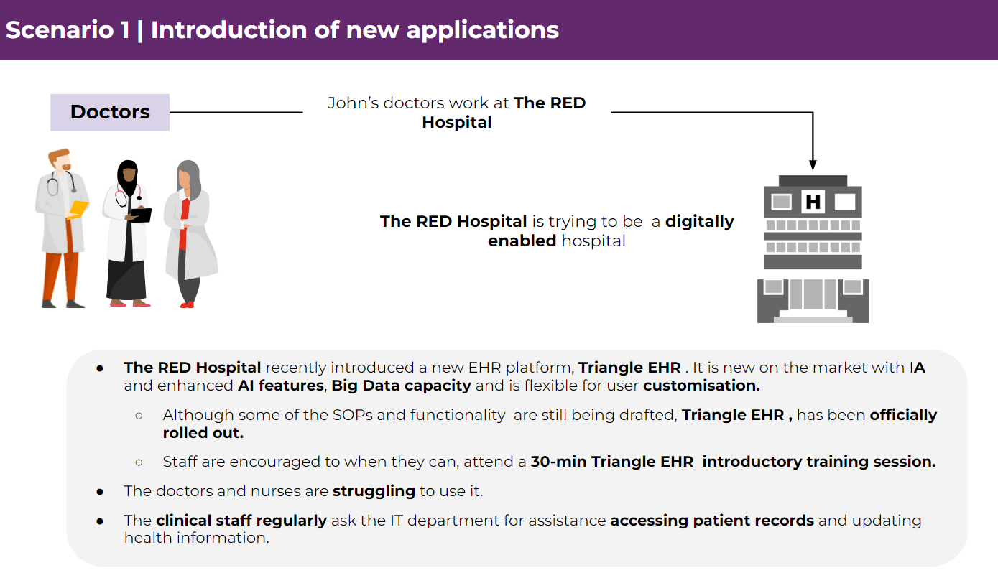
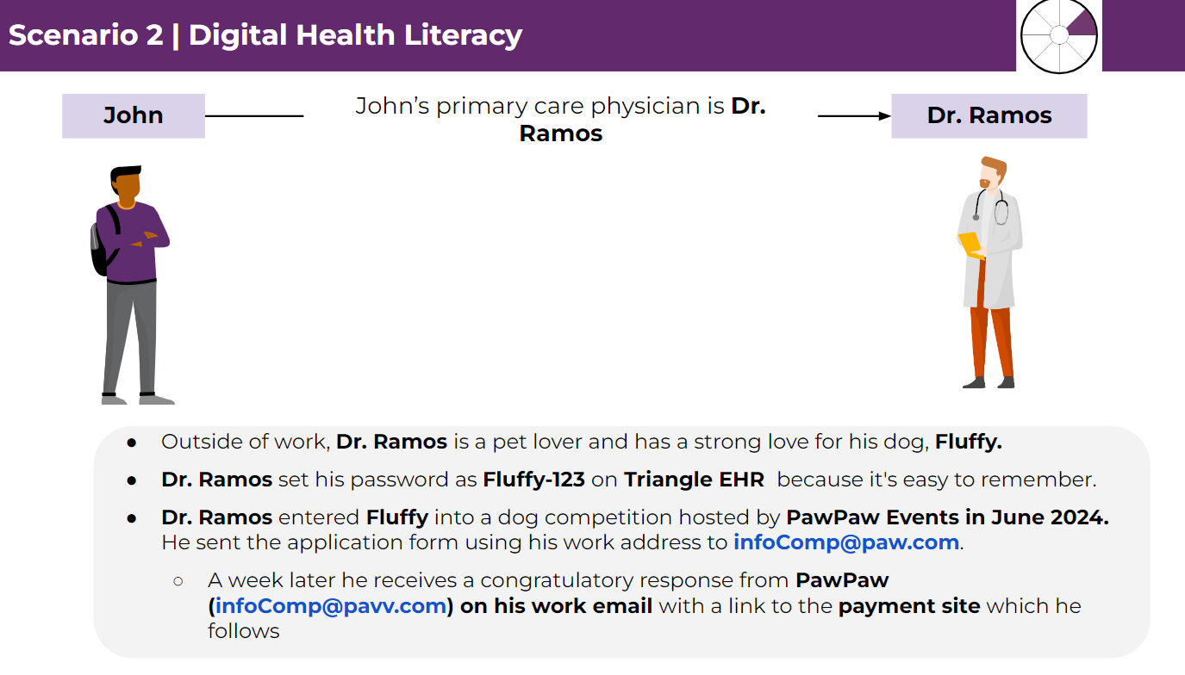
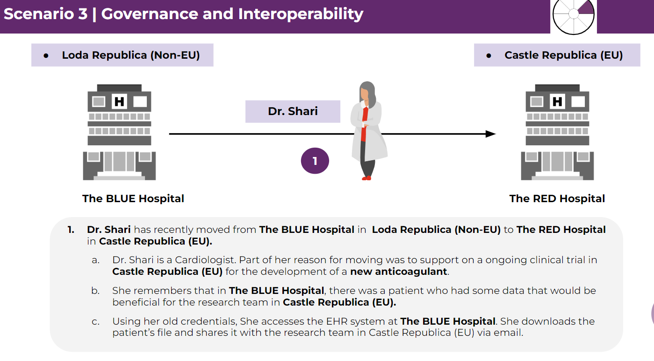
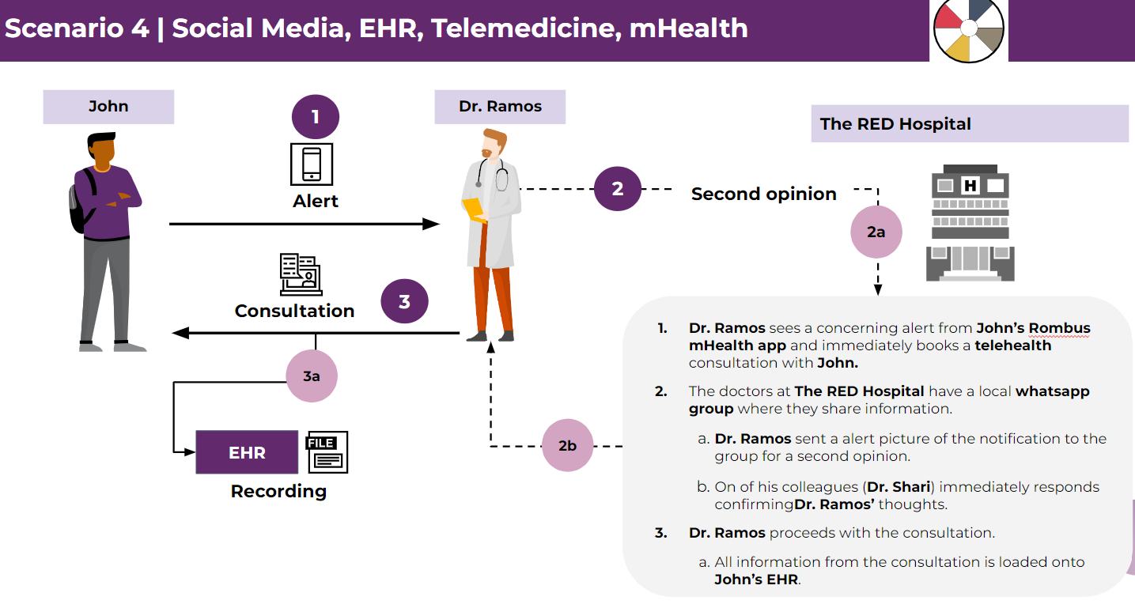
John’s scenario recap

Slide 17

Scenario 5 | Healthcare data collection & processing
Dr. Ramos
John
1
During the telehealth consultation, John reports persistent nausea and dizziness. Dr. Ramos suspects his medication to be the cause and asks John to come in for a physical examination.
Post examination, John passes by the hospital pharmacy to buy natural products and pharmaceutical items from the hospital’s health shop. June, John’s sister, is the teller on duty.
John buys his medication and leaves. After John leaves, June looks at his purchasing history. She realises her brother qualifies for 50% off his purchases if he had a loyalty card. She quickly makes him a Shop Loyalty card.
She confirms his address on the system and sends the loyalty card accompanied by a get well soon card. She texts John to look out for the card and he gratefully responds with a thank you message.
June
2
3
John
4

Slide 18
Scenario 5 | Maturity self-rating
Self-assessment
In this scenario, how did all the characters fail to collect/process John’s information safely and within regulations?
In the scenario what measures would you put in place to protect John’s data from being processed by unauthorised personnel?
Depending on your chosen model, rate your maturity level when considering your adherence to standards when collecting and processing personal health data ?

Slide 19
Considerations for healthcare data collection & processing
General Data Protection Regulation (GDPR) Recital 13
Micro, Small and Medium-Sized Enterprises
The requirements around data processing records shall not apply to an organisation with less than 250 employees
Unless:
The processing of personal data is a regular activity,
The processing poses a threat to individuals’ rights and freedoms,
The processing concerns sensitive data or criminal records,
Data Protection Officer: Only when processing is considered a part of their main business and you are dealing with processing that poses a threat to rights and freedoms of patients
Notes:
Reference
Small businesses

Slide 20

Access

Slide 21
Healthcare data access - GDPR definitions
GDPR - Article 15, 86, Recital 63
Right of access by the data subject
“The data subject shall have the right to obtain from the controller confirmation as to whether or not personal data concerning him or her are being processed, and, where that is the case, access to the personal data. The controller shall provide a copy of the personal data undergoing processing”.
The purposes of the processing;
The categories of personal data concerned;
The right to request from the controller rectification, erasure, restriction of processing or objection to such processing;
Where possible, the envisaged storage period. If not possible, the criteria used to determine that period;
Data portability: Receive personal data in a structured, commonly used, and machine-readable format and, if technically feasible, transmit it to another organisation.
Identity verification
“The controller should use all reasonable measures to verify the identity of a data subject who requests access, in the context of online services and online identifiers. A controller should not retain personal data for the sole purpose of being able to react to potential requests”.
Notes:
References
Recital 154 Principle of public access to official documents
Right of access by the data subject
Identity verification
Portability under GDOR
Data subject access requests - Data subject access requests
Under the GDPR the right of data subjects to request information about the personal data processed by employers remains largely the same. However, under the new regime employers must respond without undue delay and in any case within one month of receipt of the request. Additionally, the £10 fee for making a request will also be abolished. The new data subject rights may present practical issues for employers and HR teams, especially where employee data is spread across multiple or complex systems. Employers will need to update the relevant policies and procedures to reflect the new GDPR requirements. HR teams should review existing procedures in place when responding to data subject access requests to ensure the new time scales can be met.

Slide 22
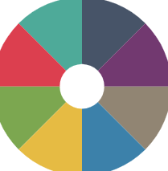
The digital health journey
Enabling environment
Information seeking
Consultation
Treatment and medication
Post-consultation
Seeking information
Profile creation
Fulfillments
Compliance
Internet
GenAI, LLM
Health Tracking Apps
Social media
Telehealth/Telemedicine
Electronic medical records (EMR)
Electronic Health records (EHR)
Health Information exchange platforms
Resources (Medscape)
Remote Care (Rehabilitation-Genie )
Hospital-at-Home
eScripts
mHealth - Apps & devices
Telehealth/Telemedicine (Follow-Up)
Social media
Patient support portals
Compliance apps
In the accessing of personal data, unauthorised access (Access to personal data that has not been explicitly permitted by the data owner or controller) is considered a personal data breach.
Inadequate access controls
Security vulnerabilities

Slide 23

Data subject, controller and owner
John
Dr. Ramos
EHR provider
Contract
Data subject
Data controller
Data processor
“The identified or identifiable natural person that the personal data relates to”
“Natural or legal person, public authority, agency or other body which, alone or jointly with others, determines the purposes and means of the processing of personal data”
“natural or legal person, public authority, agency or other body which processes personal data on behalf of the controller”
Grounds for denial
Notes:
References
Data Subject
Data Processor
Data Controller
Controller and Processor
GDPR responsibilities
The GDPR requires that processing by a processor is governed by a contract or other legal act under Union or Member State law.
In addition, the data processor shall not engage another data processor without prior specific or general written authorisation of the controller
Processing is to be carried out on behalf of a controller, controller should:
Use only data processors providing sufficient guarantees to implement appropriate technical and organisational measures required by the GDPR
Ensure the protection of the rights of the data subject.

Slide 24
Data access privileges and responsibilities
Data subject
Data controller
Data processor
They have the right to access their own personal data
They have access to personal health data as long that is necessary for performing their tasks. They are responsible for the lawful, fair, and transparent processing of personal data.
Processes personal data on behalf of the data controller. They cannot access/use the data for their own purposes. They can only process personal data based on the instructions of the data controller
Choosing an appropriate processor
Accountability
Processor contracts
Joint controller - Article 26
“Two or more controllers jointly determine the purposes and means of processing (Hospital and Research Organisation). Should in a transparent manner determine their respective responsibilities for compliance ensuring the of the rights of the data subject” This is either by arrangement or as determined by Union or Member State law.
Notes:
References
Data Subject , Access
Data Processor , Access
Data Controller, Access
Joint controllers

Slide 25
Public access to official documents
GDPR - Recital 154
Allowed when:
Public access to official documents may be considered to be in the public interest.
  If these documents have personal data, they can be made public, but only by Union or Member State law,
  Public access to official documents may be in the public interest.
Balancing Access and Privacy: Public access to official documents should still consider the protection of personal data
Reuse of Personal Data: Documents that are accessed and contain personal data cannot be reused according to the law. Doing so would go against the protection of personal data
Notes:
References
Rectal 154

Slide 26
Healthcare data access
Purpose limitation
Data minimisation
Staff should only have access to the information that they need in order to complete their duties.
Staff level | Access
Doctors | Full access to patient’s health records for treatment purposes
Nurses | Access to relevant health information for patient care
Administrators/Support | Limited access
Smart Health App Developers | De-identified user data for app improvement
EHR Managers | Full access for system maintenance, but bound by confidentiality
Social Media Platforms | No access to personal health information
Notes:
The General Data Protection Regulation (GDPR) provides a framework for the processing of personal data, including health data. Here’s how it applies to different roles in a healthcare setting and what each role is typically not allowed to access:

Slide 27
Scenario 6 | Healthcare data access
John
Dr. Ramos
1
2
John had a follow-up telehealth consultation with Dr. Ramos to check how his new treatment regimen was progressing. To prepare for the consultation, Dr. Ramos reviewed John’s EHR.
  Dr. Ramos has been struggling with the EHR system. As usual, he logs a call with Craig from Triangle EHR Solutions, the hospitals EHR business associate. On the virtual support call, Craig asks Dr. Ramos to email his login details to him so he can support from his end.
  Craig realised it was a minor driver update bug that needed to be installed. While the new drivers were installing, He decided to organise John’s EHR profile for Dr. Ramos. Craig aligns John's medical history to his purchase history at the health shop.
Following the updates, Dr. Ramos proceeded with the telehealth consultation.
1b
1a
EHR provider
Triangle EHR Solutions
Craig

Slide 28
Scenario 6 | Maturity self-rating
Self-assessment
In the scenario, what did Dr. Ramos, John, Craig and Triangle EHR solutions do that was incorrect when ensuring the security of John’s data?
What data security risks could John’s data be exposed to in the scenario?
Depending on your chosen model, rate your maturity level when considering standards for ensuring access control for personal data ?

Slide 29
Considerations for healthcare data access
EHR (Repository)
Staff
EHR’s have large amounts of sensitive information and are increasingly becoming targets for cyber attacks
Staff pose a significant risk to cyber resilience if they are not properly trained and aware of the regulations
Access controls and authentication - Strong access controls to prevent unauthorised access (MFA)
Training - Regular training to keep staff educated about regulatory requirements
Encryption and data integrity - Safeguarding through encryption and ensuring data integrity
Policies & procedures - Policies & procedures that detail the expectations and standards for data protection by/from staff
Data backup and disaster recovery - Secure backup systems and recovery plans for data loss/corruption
Accountability and responsibility - Defining clearly the staff roles and responsibilities in data protection
Insider threats and employee training - Employees accessing or leaking patient data - data breach
Regular assessments - Evaluate effectiveness of data protection measures with regular auditing and assessment
System vulnerabilities - Keep systems up to date, avoid legacy systems and minimise data fragmentation
Communication and awareness - Promoting a culture of data protection by regular communication and updates
Notes:
References
GDPR and Electronic Health Records and Staff

Slide 30

5 min Break

Slide 31

Protection

Slide 32
“Specific measures to safeguard the fundamental rights and the interests of the data subject”
Healthcare data protection
Notes:
Trust is critical!

Slide 33
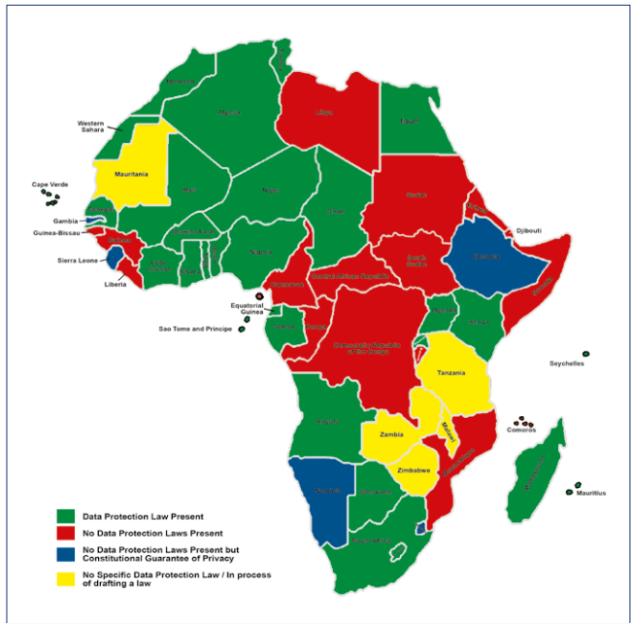
Healthcare data protection challenges
Challenges in data protection in Africa
“the process of safeguarding personal information, in accordance with a set of principles laid down by law”
The IBA African Regional Forum
Notes:
Challenging to protect data across developing countries - gaps exist in maturity
However be aware of data protection laws - the country you are sending data may not have data protection laws
Awareness - POPI - international guidelines and regsulations
Kenya - most comprehensive data protection laws…read and
Nigeria - data protection laws
Various Accountabilities:
This depends where the complaint is raised?
Highest level of data compliance must be considered!
References
Challenges in Data protection
Data protection is the process of safeguarding personal information, in accordance with a set of principles laid down by law
Africa’s data protection/privacy ecosystem is largely influenced by Europe’s uniform approach that looks at an omnibus law which governs both public and private sectors while recognising data protection/privacy as a human right.
Although the African continent has witnessed some dynamic and progressive frameworks and laws on data protection/privacy, the ecosystem can still best be described as ‘underdeveloped and disparate’.
Due the unconsolidated nature of the laws across Africa, there are also challenges around the cross-border data transfers within Africa as well as between Africa and the rest of the world. The existing laws on cross-border transfers are varied, with countries that have restrictions on transfers and others that do not.

Slide 34

Healthcare data protection - GDPR definitions
GDPR - Article 51
Supervisory authority
“Independent public authority which is established by a Member State. Responsible for monitoring the application of this regulation, for the protection of the rights and freedoms of natural persons when processing or transferring personal data within the Union”
UK: The Information Commissioner’s Office (ICO), IRE: The Data Protection Authority (DPA)
Notes:
Following on with roles and responsibilities under data protection under all regulations…eg. POPIA, GDPR, HIPA etc.
Responsibility to protect patient data rights and not everyone has the capacity to safeguard to protect data
GDPR - because of variety of EU member states select a lead supervisory authority instead of being responsible to each
Independent public authority - the Spervisory Authority is responsible in each EU state would monitor the application of GDPR….
Side not: DPIA are being completed continously …..enforced by the supervisory authority
References
Supervisory Authority

Slide 35
Data protection officer
GDPR - Article 13, 14, 37, 38, 39, 51 - Recital 97
The GDPR has clear guidelines on appointment of a
data protection officer (DPO)
Jane - DPO
Appointed based on professional qualities, expert knowledge of data protection law and practices.
Inform and advise the controller or the data processor and the employees, who carry out processing, of their obligations.
Monitor compliance with GDPR regulation or other Union or Member State data protection provisions.
Give advice on the data protection impact assessment and monitor its performance.
Independent
Ensure cooperation with the supervisory authority and act as the contact point for the supervisory authority on issues relating to processing.
Notes:
Directly under the supervisory authority is the DPO (both are independent) - employed by the healthcare facility
NB. must be extremely qualified and aware of data protection - is the liaison between the healthcare facility and Supervisory Authority
References
37 - DPO
39 - DPO
DPO - Recital 97
Data Protection Officer
DPO - The necessary level of expert knowledge should be determined in particular according to the data processing operations carried out and the protection required for the personal data processed by the controller or the processor. Such data protection officers, whether or not they are an employee of the controller, should be in a position to perform their duties and tasks in an independent manner.
A group may appoint a single DPO who must be easily contactable by each establishment.
The DPO must be provided with the resources necessary to carry out his or her obligations under the GDPR

Slide 36
Data protection impact assessments
GDPR - Article 35, 36 - Recitals 75, 84, 89-93
A data controller is required to, where necessary, review whether the processing of personal data is in accordance with the DPIA
Allowed when:
Data controller is using new technologies to process personal data.
Processing, may result in a high risk to the data subject rights and freedoms.
Processing of special categories of data on a large scale.
Systematic monitoring of a publicly accessible area on a large scale
Systematic and extensive evaluation of personal/individual aspects relating to natural persons which is based on automated processing/profiling
Notes:
The allowed conditions is dynamic…..based on adaption of technology and threats eg. AI hence DPIA required
References
Data Protection Officer
Data Protection Impact assessment
35 - DPIA
Impact assessment
The controller shall seek the advice of the data protection officer, where designated, when carrying out a data protection impact assessment
The supervisory authority shall establish and make public a list of the kind of processing operations which are subject to the requirement for a data protection impact assessment pursuant to paragraph
The supervisory authority may also establish and make public a list of the kind of processing operations for which no data protection impact assessment is required.
Systematic and Extensive Evaluation: This refers to automated processes, including profiling, that make decisions which have legal or significant effects on individuals. For example, an algorithm that decides whether someone is eligible for a loan based on their personal data.
Large Scale Processing of Special Categories of Data: This involves processing sensitive data on a large scale. Special categories of data include things like race, religion, political opinions, health information, etc. It also includes data about criminal convictions and offences.
Systematic Monitoring of a Publicly Accessible Area on a Large Scale: This could refer to something like surveillance cameras in a city center that continuously monitor the area.

Slide 37
Data protection impact assessments
Should contain:
A description of the envisaged processing.
Purposes of the processing.
An assessment of the necessity and proportionality of the processing operations compared to the purpose.
An assessment of the risks to the rights and freedoms of data subjects.
The measures to address the risks, including safeguards, security measures and mechanisms to ensure the protection of personal data.
Notes:
References
35 - DPIA
Data Protection Officer
Data Protection Impact assessment

Slide 38
Scenario 7 | Healthcare data security and protection
John
Dr. Ramos
From before - John had a follow-up telehealth consultation with Dr. Ramos to check how his new treatment regimen was progressing. To prepare for the consultation, Dr. Ramos was looking through John’s EHR.
From before - Following the updates to John’s EHR, Dr. Ramos proceeded with the telehealth consultation.
Jane learns of what happened between Dr. Ramos and Craig., She also learns that Craig has been doing this for other doctors because they are struggling with Triangle EHR .
1
2
Jane - DPO
1b
Scenario 6
1a
3
EHR provider
Triangle EHR Solutions
Craig

Slide 39
Scenario 7 | Maturity self-rating
Self-assessment
What do you think are the root causes of the data protection failures in the above scenario?
Now that Jane (DPO) knows what has been happening in the hospital, list some action steps she should consider to start remedying the situation.
Depending on your chosen model, rate your maturity level when considering standards for protection of personal data?

Slide 40
Considerations for healthcare data access
Purpose limitation
Data minimisation
“The controller shall implement appropriate technical and organisational measures for ensuring that, by default, only personal data which are necessary for each specific purpose of the processing are processed”
GDPR Article 25: Data protection by design and by default
Notes:
Multi-Factor Authentication (MFA): HIPAA: 2023 Healthcare Data Breach Report
Adoption of MFA is taking place in over 90% of surveyed hospitals; however, data suggests that MFA may not be utilized consistently across key systems and critical entry points, creating additional risk of exploitation. For instance, 84% of Virtual Private Networks (VPNs) are protected with MFA, and 88% of email systems protected with MFA. Given a lack of full adoption on critical assets, it can be concluded that single credential theft through phishing attacks can lead to successful compromises.

Slide 41
5 min Break

Slide 42

1
The Fundamentals of data security in healthcare
Covering principles relating to Healthcare data transfer and exchange and interoperability Interactive session - Scenario 8: John’s data journey and maturity self-rating scenario Considerations for health data transfer Data breaches in healthcare Interactive session - Scenario 9: John’s data journey and maturity self-rating scenario Considerations for health data security
2
Regulations and guidelines in the Digital Health Ecosystem
3
The operating environment
4
Regulatory requirements for healthcare data
5
Guidelines and principles for data compliance and protection in operations
6
Practical applications and examples for health data security

Slide 43
Healthcare data

Slide 44

Transfer/Exchange
Notes:
Many touch points within and across different jurisdictions….eg. telehealth - sharing information must be safe and not violate patients rights …no need to share all of a patients history if not necessary….medical tourism….ecosystem that is more connected because of technology, assisted surgeries…..how information moves and is protected is critical…compliance is exceptionally critical? How is data protected, transferred (not social media)

Slide 45
Healthcare data transfer - GDPR definitions
GDPR - Article 4, 51
Recipient
“Natural or legal person, public authority, agency or another body, to which the personal data are disclosed, whether a third party or not. Public authorities which may receive personal data in the framework of a particular inquiry in accordance with Union or Member State law shall not be regarded as recipients”
Third party
“Natural or legal person, public authority, agency or body other than the data subject, controller, processor and persons who, under the direct authority of the controller or processor, are authorised to process personal data”
Cross-border processing
“Processing of personal data which takes place in more than one Member State of a controller or processor in the Union where the controller or processor is established in more than one Member State”
“Processing of personal data which takes place in the Union but which substantially affects or is likely to substantially affect data subjects in more than one Member State”
Notes:
Cross border - 2 scenarios….egxamples
References
Definitions

Slide 46
Healthcare data transfer
GDPR - 40, 42, 44, 45 46, 47, 93 - Recital 101, 102, 108
Data processing agreements
Data protection safeguards
There should be legally binding agreements with third parties for transfers that specify purpose, scope and obligations.
Third parties should have adequate technical and organisational capacity to protect patient data (DPIA).
International data transfers
Patient notification and consent
International transfers (outside EEA) need to ensure that adequate safeguards to protect patient data (Implementing Act with Concessions).
Patients should be informed and explicit consent should be obtained clearly explaining nature and purpose of the transfer.
Transfer/ Exchange
Notes:
EEA - European Economic Area
Person sharing data with should be able to protect that data - has a DPIA been complete to ensure that processes in place to protect data…
Understand regulations and frameworks in place to share and protect data
If sharing beyond borders eg. EU to NON-EU, how is data protected….assessment must be complete via a DPIA….
References
Transfer - 44
Recital 101
Adequacy
Transfer
Implementation Act: - If the Commission decides that the level of protection is adequate, they issue an ‘implementing act’. This is a formal decision that allows data to be transferred to that third country, region, or organization
Periodic review: Every four years
Monitoring
Constantly monitor for any changes that could affect data protection.
If adequacy level changes then EU commission can repeal, amend or suspend the decision
Can enter into consultation to remedy the situation
Published list of countries with adequate third-country data protection (Official Journal of the European Union)
A transfer of personal data to a third country or an international organisation may take place where the Commission has decided that the third country, a territory or one or more specified sectors within that third country, or the international organisation in question ensures an adequate level of protection. Such a transfer shall not require any specific authorisation.
When assessing the adequacy:
the rule of law, respect for human rights and fundamental freedoms, relevant legislation, both general and sectoral, including concerning public security, defence, national security and criminal law and the access of public authorities to personal data, as well as the implementation of such legislation, data protection rules, professional rules and security measures, including rules for the onward transfer of personal data to another third country or international organisation which are complied with in that country or international organisation, case-law, as well as effective and enforceable data subject rights and effective administrative and judicial redress for the data subjects whose personal data are being transferred;
the existence and effective functioning of one or more independent supervisory authorities in the third country or to which an international organisation is subject, with responsibility for ensuring and enforcing compliance with the data protection rules, including adequate enforcement powers, for assisting and advising the data subjects in exercising their rights and for cooperation with the supervisory authorities of the Member States
the international commitments the third country or international organisation concerned has entered into, or other obligations arising from legally binding conventions or instruments as well as from its participation in multilateral or regional systems, in particular in relation to the protection of personal data.
Concessions
If there is no implementation act:
Controller or processor has provided appropriate safeguards
Enforceable data subject rights and effective legal remedies for data subjects are available - Data subjects have legal recourse
There should be
Legally Binding Instrument -
Binding corporate rules - Article 47
Standard Data Protection Clauses by the Commission - Article 93: EU Commission's standard contractual clauses for companies
Standard Data Protection Clauses by a Supervisory Authority - Article 93:
Approved Code of Conduct Article 40.
Approved Certification Mechanism Article 42: a cloud storage company in the US might obtain a certification that it meets European data protection standards
Data processing agreements
Data processing agreements: Healthcare organisations should have legally binding agreements in place with third parties, specifying the purpose, scope, and obligations related to the processing of patient data.
Data protection safeguards: Ensure that the third party has appropriate technical and organisational measures in place to protect patient data and comply with GDPR.
International data transfers: When transferring patient data outside the European Economic Area (EEA), healthcare organisations must ensure that adequate safeguards are in place. This can include using standard contractual clauses, obtaining explicit consent, or relying on approved certification mechanisms.
Patient notification and consent: Inform patients about the potential sharing of their data with third parties and obtain their explicit consent, providing them with sufficient information about the nature and purpose of the sharing

Slide 47
Healthcare data transfer - derogations
GDPR - Article 49. Recital 111, 112, 115, 108 - Absence of an Adequate decisions
Data subject explicit consent
Performance of a contract - Specialist transfer
Conclusion or performance of a contract - Insurance to international organisation
Public interest - COVID-19
Vital interests of data subject or others - Medical emergency
Legal claims - Intonation, malpractice, lawsuit
Public register - International organisation conducting research
Notes:
Covid is a great example …..public interest
References
Derogations - The controller or processor shall document the assessment as well as the suitable safeguards
Permitted derogations
Public register: A transfer pursuant to point (g) of the first subparagraph of paragraph 1 shall not involve the entirety of the personal data or entire categories of the personal data contained in the register
Consent, Contract performance, Contract conclusion: shall not apply to activities carried out by public authorities in the exercise of their public powers
Public interest: Should be recognised in Union law or in the law of the Member State to which the controller is subject

Slide 48
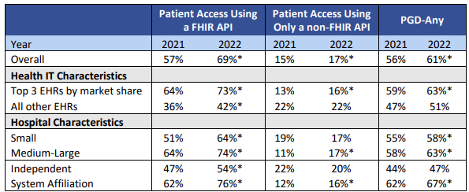
Healthcare data transfer - data portability
GDPR - Article 20, Recital 68
Data portability
“Data subjects have the right to receive the personal data concerning them, which they provided to a controller, in a structured, commonly used and machine-readable format. Subjects have the right to transmit those data to another controller without hindrance from the currently holding controller.
Data transmission
Automated
FHIR
Interoperability
FHIR API
Health data transfer
Application Programming Interfaces (API)
“Technology that allows one software program to access the services provided by another software program making it easier to share important health information”
Hospitals using APIs to enable patient access
Notes:
Speaking to the different systems and stakeholders….locally and across
As you transfer data, should not be difficult…API makes this possible for FHIR to transfer and ensure safe portability
Person has the right to request information - should be easy to understand
Data transmission - should be automated and not share by email etc.
FHIR - popular due to safety in transferring information, patients can access information via FHIR….
NB. Data portability should be seamlessly transferred and easy portability - safe, common easy to read and patients and healthcare workers to transfer and access data
References
Portability , Portability recital
API's
Data Access and Transfer
The processing of the data is based on the patient’s consent or on a contract.
The processing is carried out by automated means.
The party who decides the purpose and the means of processing a data subject’s personal information is the responsible party under POPIA and the controller under GDPR.
APIs are technology that allow one software program to access the services provided by another software program. APIs hold the ability to revolutionize healthcare data sharing, as it has already revolutionized data sharing in other sectors such as the financial and airline industries - Online and smart phone banking are enabled by APIs.
Direct Data Transmission: When exercising their right to data portability, the patient has the right to have their personal data transmitted directly from one healthcare provider to another
FHIR API - FHIR-API , Hospital use of FHIR-API
Hospital use of a FHIR API to enable patient access to data increased notably between 2021 and 2022, but hospital use of only a non-FHIR API for the same purpose and any API to support patient generated health data (PGHD) submission stayed nearly level.
The percentage of hospitals offering patient access to health information through apps using a FHIR API has increased year-over-year across all stratifications of hospital and health IT characteristics.
Year-Over-Year Growth: The percentage of hospitals providing patient access through FHIR APIs has consistently increased over time.

Slide 49
Scenario 8 | Healthcare data transfer
Rombus mHealth sent the data to The RED Hospital in proprietary format.
Castle Republica
X
NON-EU
1b
Nodava
Rombus mHealth
1
1a
During the follow-up telehealth consultation, John tells Dr. Ramos of a hiking trip abroad. Dr. Ramos asks John to send his mHealth data so that he can give him comprehensive advice.
John requested his health data from Rombus mHealth, his mHealth provider.
The YELLOW Hospital
Dr. Ramos
2
3
John
Due to time pressure, Dr. Ramos permits John to go before he gets the correct data from Rombus mHealth.
John travels to Nodava from Castle Republica (EU).
While hiking, John falls suffering a fracture. Internal bleeding from the fracture causes a clot and DVT. John complains of chest pain indicating a possible pulmonary embolism (PE). The YELLOW Hospital calls The RED Hospital requesting John’s EHR to understand his full medical history before initiating treatment.
4
Craig
Dr. Ramos is driving to work. He calls Craig to login to his EHR profile and quickly email John’s EHR to The YELLOW Hospital.
5

Slide 50
Scenario 8 | Maturity self-rating
Self-assessment
Self-Assessment
What data security mistakes were made by John, Dr. Ramos, Rombus mHealth, The RED Hospital, The YELLOW Hospital, and Craig in the scenario?
In your view, at what point should the scenario have been stopped immediately and why?
What data security mistakes were made by John, Dr. Ramos, Rombus mHealth, The RED Hospital, The YELLOW Hospital, and Craig in the scenario ?
In your view, at what point should the scenario have been stopped immediately and why ?
Depending on your chosen model, rate your maturity level considering standards for the transfer and exchange of patient data?

Slide 51
Healthcare data transfer - considerations
Interoperability
Data portability
Data subject interest over Controller/Processor interest
Understand domestic legal obligations and guidelines first
Thorough due diligence
Draft clear data protection agreements with partners
Conduct regular review of laws (DPIA/Risk Assessment )
Implement robust contractual clauses and binding corporate rules
Notes:
References
Best practices
Considerations
Binding corporate rules: means personal data protection policies which are adhered to by a controller or processor established on the territory of a Member State for transfers or a set of transfers of personal data to a controller or processor in one or more third countries within a group of undertakings, or group of enterprises engaged in a joint economic activity;

Slide 52
APAC policy maker recommendations
APAC report: Cross-border health data flow
Basic level of preparedness
“Address challenges of digitalising health data and legacy manual systems. Focussed approach on accelerating regulatory development aimed at addressing the nature of health data”
Intermediate level of preparedness
“Specifically target and consider health data within wider data sharing frameworks and policies. Consider creation of a national level body to be responsible for the governance of all health data use”
Advanced level of preparedness
“Leading and Supporting regional ambitions to influence and align with global frameworks as well as and striving for the addresal of interoperability challenges delaying global health systems digital maturity development”
Notes:
APAC Countries specific and could apply to organisations (check this….) Advances - sharing across multiple organisations - maturity requires leading and influencing and also ongoing joint responsibility
ti
Reference
APAC HIMSS recommendations

Slide 53

15 min Break

Slide 54

Data Breaches

Slide 55
Health data security
GDPR - Article 6, 32, 34 - Recital 39, 40
Personal data breach
“breach of security leading to the accidental or unlawful destruction, loss, alteration, unauthorised disclosure of, or access to, personal data transmitted, stored or otherwise processed”
Breach - HIPAA
“an impermissible use or disclosure under the Privacy Rule that compromises the security or privacy of the protected health information ”
Encryption
“the procedure that converts clear text into a hashed code using a key, where the outgoing information only becomes readable again by using the correct key”
Minimises the risk of an incident during data processing
Notes:
Different data breach definitions, why encryption is important- protection. POPI breach
References
Encryption
Encryption is the best way to protect data during transfer and one way to secure stored personal data.
Encrypted contents are basically unreadable for third parties who do not have the correct key.
Regulation also recognizes these risks when processing personal data and places the responsibility on the controller and the processor in Art. 32
Definitions
Lawfulness
However, it gives the controller a catalogue of criteria to be considered when choosing methods to secure personal data. Those are the state of the art, implementation costs and the nature, scope, context and purposes of the processing
HIPAA

Slide 56
Health data security - processing
“The higher the risks involved in data processing, the more likely these are to manifest”
Controller & processor
When processing patient data, Consider the technical and organisational measures to ensure a level of security appropriate to the risk
Use of pseudonyms and encryption of personal data.
Ability to ensure the ongoing confidentiality, integrity, availability and resilience of processing.
Ability to restore the availability and access in a timely manner in the event of a physical or technical incident.
A process for regularly testing the effectiveness of technical and organisational measures for ensuring the security.
Notes:
Not to explain- but how to avoid and what can help with breaches. Bring in safe transfers
References
Encryption
To answer the question of what is currently considered “state of the art” data protection officers usually rely on the definitions set out in information security standards like ISO/IEC 27001 or other national IT-security guidelines.
Security of processing
“The pseudonymisation and encryption of personal data”
Pseudonymisation and encryption: This means replacing identifying fields within a data record with artificial identifiers to protect personal data.
“The ability to ensure the ongoing confidentiality, integrity, availability and resilience of processing systems and services”
Confidentiality, integrity, availability, and resilience: Organizations should make sure their data processing systems and services are reliable, secure, and can recover quickly from any incidents.
“The ability to restore the availability and access to personal data in a timely manner in the event of a physical or technical incident”
Restoring availability and access: If there’s a physical or technical problem, organizations should be able to restore access to personal data quickly.
“A process for regularly testing, assessing and evaluating the effectiveness of technical and organisational measures for ensuring the security of the processing”
Regular testing and evaluation: Organizations should regularly check and evaluate how effective their security measures are. This helps ensure the ongoing security of data processing.

Slide 57
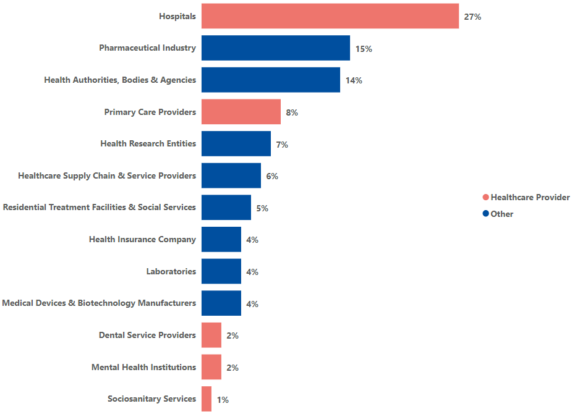
Health data security - data breaches
Affected healthcare entities of breach or theft of data
Notes:
Every type of organization is a target- across the ecosytem
EU data! This is the first analysis conducted by the European Union Agency for Cybersecurity (ENISA) of the cyber threat landscape of the health sector in the EU. The report aims to bring new insights into the reality of the health sector by mapping and studying cyber incidents from January 2021 to March 2023. It identifies prime threats, actors, impacts and trends based on the analysis of cyberattacks targeting health organisations over a period of more than 2 years.
we considered four main categories of cybersecurity threat actors: cybercriminals, hackers-for-hire, state-sponsored actors and hacktivists.
• Cybercriminals’ primary motive is financial gain, often stealing data or demanding ransom.
• Hackers-for-hire sell their services to people who do not have the skills or capabilities to do so. They will be included as part of the cybercrime ecosystem in this report.
• State-sponsored actors target organisations to compromise, steal, change or destroy information. These groups are usually affiliated with a nation state32.
• Hacktivists are politically, socially or ideologically motivated and target victims for publicity or to effect change
References
Health Landscape

Slide 58
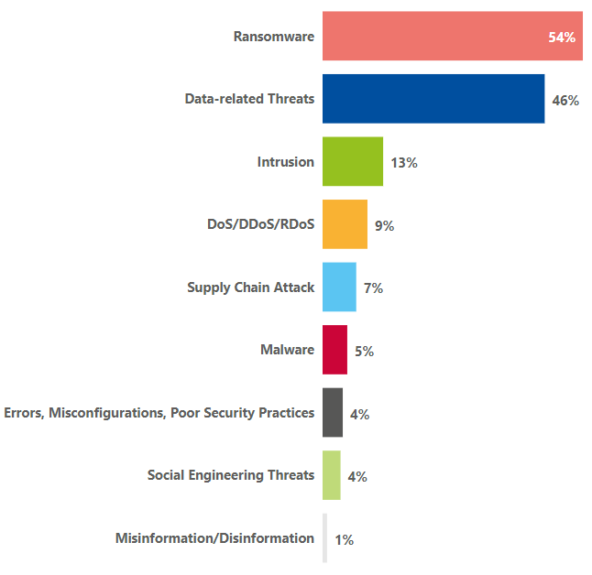
Health data security - data breaches cont.
“Personal data should be processed in a manner that ensures appropriate security and confidentiality of the personal data”
Threats in the health sector
Notes:
Training/ policies on these threats is critical
A distributed denial-of-service (DDoS) attack is a malicious attempt to disrupt the normal traffic of a targeted server, service or network by overwhelming the target or its surrounding infrastructure with a flood of Internet traffic.
Can this slide come first? What is supply chain? References
Health Landscape
Electronic health records and patient data include a patient’s medical history and other health data that is sensitive information and crucial for treating a patient adequately, because it can provide clues for diagnosis and treatment, such as the patient's allergies or contraindications in medication.
Health information systems and services include the information systems and services that are key in patient care. They usually include registrations and appointments, tracking patient progress, laboratory services, access to pharmacy services, smart devices for healthcare, automated systems for monitoring the care of the elderly, emergency buttons, etc.
Non-medical IT systems and networks include the remainder of the IT systems that are not used for patient care, for example, the web page of the institution, administrative systems, etc.
Corporate and personnel related data is information that is not related to patient care. This information is confidential but not associated with healthcare.
Intellectual property includes information related to patents, non-functional aspects of a medical device or theories and results associated with scientific research.
Citizens are the most valuable assets in the health sector because that sector relates to the improvement of the quality of their lives.
Health Landscape
RANSOMWARE - hackers seize control of a target’s assets and demand a ransom, accounted for 54% of identified incidents, disrupting services, particularly in healthcare. The impact ranged from data breaches and potential data leaks to severe disruptions in healthcare services, including the suspension of operations and diversion of emergencies in hospitals.
THREATS AGAINST DATA - Often linked to ransomware and malware, result in unauthorized access, disclosure, and potential manipulation of data, leading to confirmed data loss or leaks, intellectual property theft, and other data-related issues.

Slide 59
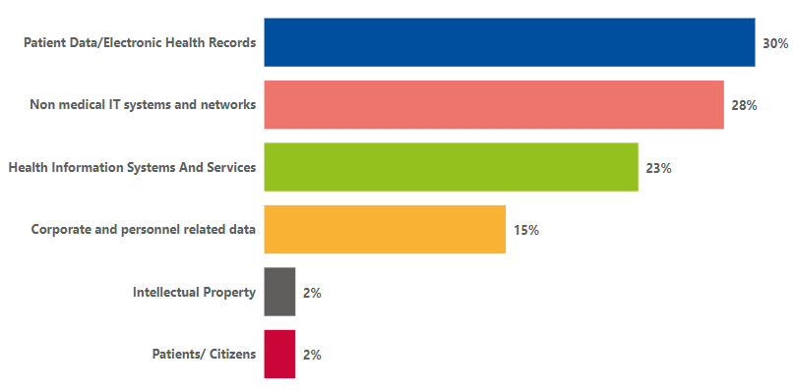
Health data security - data breaches cont.
“Personal data should be processed in a manner that ensures appropriate security and confidentiality of the personal data”
Cyber threats in the health sector
Notes:
Impact- affected assets: Reformat image?
Main impacts/ consequences include: breach/ theft of data, disruption of services (healthcare/ non healthcare), reputional harm, ptx safety, legal regulatory, financial loss/ multiple consequences
References
Health Landscape
Electronic health records and patient data include a patient’s medical history and other health data that is sensitive information and crucial for treating a patient adequately, because it can provide clues for diagnosis and treatment, such as the patient's allergies or contraindications in medication.
Health information systems and services include the information systems and services that are key in patient care. They usually include registrations and appointments, tracking patient progress, laboratory services, access to pharmacy services, smart devices for healthcare, automated systems for monitoring the care of the elderly, emergency buttons, etc.
Non-medical IT systems and networks include the remainder of the IT systems that are not used for patient care, for example, the web page of the institution, administrative systems, etc.
Corporate and personnel related data is information that is not related to patient care. This information is confidential but not associated with healthcare.
Intellectual property includes information related to patents, non-functional aspects of a medical device or theories and results associated with scientific research.
Citizens are the most valuable assets in the health sector because that sector relates to the improvement of the quality of their lives.
Health Landscape
RANSOMWARE - hackers seize control of a target’s assets and demand a ransom, accounted for 54% of identified incidents, disrupting services, particularly in healthcare. The impact ranged from data breaches and potential data leaks to severe disruptions in healthcare services, including the suspension of operations and diversion of emergencies in hospitals.
THREATS AGAINST DATA - Often linked to ransomware and malware, result in unauthorized access, disclosure, and potential manipulation of data, leading to confirmed data loss or leaks, intellectual property theft, and other data-related issues.

Slide 60
Health data security - data breach notification
GDPR - Article 33, 34 - Recital 85, 87, 88
Notification of a personal data breach
Processor shall notify the controller
“The controller shall where feasible, not later than 72 hours after becoming aware of a data breach notify the supervisory authority. Where if the notification to the supervisory authority is not made within 72 hours, it shall be accompanied by reasons for the delay”
Data Subject notification
Nature of the personal data breach
Breach is a high risk to rights and freedoms
Contact point details (DPO)
Data is unintelligible to authorised assessor - encrypted
Potential consequences
Mitigation reduced high risk occurrence
Addressal and mitigation measures
Disproportionate effort - Public communication
Notes:
data protection officer (DPO)/communicate the name and contact details of the data protection officer or other contact point where more information can be obtained; (86) Notification of Data Subjects in Case of Data Breaches (87) Promptness of Reporting / Notification (88) Format and Procedures of the Notification.
Similar proces to HIPA
References
Notification 85 - Where such notification cannot be achieved within 72 hours, the reasons for the delay should accompany the notification and information may be provided in phases without undue further delay.
Promptness of notification - The fact that the notification was made without undue delay should be established taking into account in particular the nature and gravity of the personal data breach and its consequences and adverse effects for the data subject. Such notification may result in an intervention of the supervisory authority in accordance with its tasks and powers laid down in this Regulation.
The fact that the notification was made without undue delay should be established taking into account in particular the nature and gravity of the personal data breach and its consequences and adverse effects for the data subject. Such notification may result in an intervention of the supervisory authority in accordance with its tasks and powers laid down in this Regulation.
Data breach : The notification referred to in paragraph 1 shall at least:
Describe the nature of the personal data breach including where possible, the categories and approximate number of data subjects concerned and the categories and approximate number of personal data records concerned
Communicate the name and contact details of the data protection officer or other contact point where more information can be obtained
describe the likely consequences of the personal data breach
describe the measures taken or proposed to be taken by the controller to address the personal data breach, including, where appropriate, measures to mitigate its possible adverse effects
Patient notification
The communication to the data subject referred to in paragraph 1 of this Article shall describe in clear and plain language the nature of the personal data breach and contain at least the information and measures referred to in points (b), (c) and (d) of Supervisory authority notification (33)
Notification is not required when:
The controller has implemented appropriate technical and organisational protection measures, and those measures were applied to the personal data affected by the personal data breach, in particular those that render the personal data unintelligible to any person who is not authorised to access it, such as encryption;
The controller has taken subsequent measures which ensure that the high risk to the rights and freedoms of data subjects referred to in paragraph 1 is no longer likely to materialise;
It would involve disproportionate effort. In such a case, there shall instead be a public communication or similar measure whereby the data subjects are informed in an equally effective manner.
The need to mitigate an immediate risk of damage would call for prompt communication with data subjects whereas the need to implement appropriate measures against continuing or similar personal data breaches may justify more time for communication

Slide 61

Health data security - data breach notification procedure
Data breach
3. Notify relevant authorities
Report to the DPO
4. Analyse breach comprehensively
2. Assess the scope and impact
Low risk
High risk
After containing the personal data, review the remedial measures and their capacity to prevent reoccurence.
Monitor constantly to stay updated on cybersecurity risks
5. Remedial action
Notify patients/public communication
Notes:
DPIA to enforce
Data protection officer- refer to previous slide on data subject notification

Slide 62
Health data security - penalties for data breaches
GDPR - Article 58, 79, 83,84 - Recital 141, 148
Right to lodge complaint
“each data subject shall have the right to an effective judicial remedy where the subject considers that the subjects rights have been infringed as a result of the processing of the subjects personal data in non-compliance”
To strengthen enforcement of the rules:
Supervisory authority
Circumstances
Penalties
Withdrawal of Certification
Reprimands
Up to €10 000 000
2 % of the total global turnover
Warnings
Administrative fine
Suspension of of transfer
Temporary or definitive ban
Notes:
Bring e.g. mobile company in UK fined for transfer.
Penalty dependent on circumstances.
References
79 - Complaint
Without prejudice to any available administrative or non-judicial remedy, including the right to lodge a complaint with a supervisory authority pursuant to Article 77, each data subject shall have the right to an effective judicial remedy where he or she considers that his or her rights under this Regulation have been infringed as a result of the processing of his or her personal data in non-compliance with this Regulation.
Proceedings against a controller or a processor shall be brought before the courts of the Member State where the controller or processor has an establishment. Alternatively, such proceedings may be brought before the courts of the Member State where the data subject has his or her habitual residence, unless the controller or processor is a public authority of a Member State acting in the exercise of its public power
The Right of Data Subjects to Mandate a Not-For-Profit Body, Organisation or Association - Recital 142
Where a data subject considers that his or her rights under this Regulation are infringed, he or she should have the right to mandate a not-for-profit body, organisation or association which is constituted in accordance with the law of a Member State, has statutory objectives which are in the public interest and is active in the field of the protection of personal data to lodge a complaint on his or her behalf with a supervisory authority, exercise the right to a judicial remedy on behalf of data subjects or, if provided for in Member State law, exercise the right to receive compensation on behalf of data subjects.
A Member State may provide for such a body, organisation or association to have the right to lodge a complaint in that Member State, independently of a data subject’s mandate, and the right to an effective judicial remedy where it has reasons to consider that the rights of a data subject have been infringed as a result of the processing of personal data which infringes this Regulation
That body, organisation or association may not be allowed to claim compensation on a data subject’s behalf independently of the data subject’s mandate.
Supervisory Authority Powers , Administrative fines
Each supervisory authority shall ensure that the imposition of administrative fines pursuant to this Article in respect of infringements of this Regulation referred to in paragraphs 4, 5 and 6 shall in each individual case be effective, proportionate and dissuasive.
to issue warnings to a controller or processor that intended processing operations are likely to infringe provisions of this Regulation;
to issue reprimands to a controller or a processor where processing operations have infringed provisions of this Regulation;
to order the controller or the processor to comply with the data subject’s requests to exercise his or her rights pursuant to this Regulation;
to order the controller or processor to bring processing operations into compliance with the provisions of this Regulation, where appropriate, in a specified manner and within a specified period;
to order the controller to communicate a personal data breach to the data subject;
to impose a temporary or definitive limitation including a ban on processing;
to order the rectification or erasure of personal data or restriction of processing pursuant to Articles 16, 17 and 18 and the notification of such actions to recipients to whom the personal data have been disclosed pursuant to Article 17(2) and Article 19;
to withdraw a certification or to order the certification body to withdraw a certification issued pursuant to Articles 42 and 43, or to order the certification body not to issue certification if the requirements for the certification are not or are no longer met;
to impose an administrative fine pursuant to Article 83, in addition to, or instead of measures referred to in this paragraph, depending on the circumstances of each individual case;
to order the suspension of data flows to a recipient in a third country or to an international organisation.
Administrative fines
Administrative fines shall, depending on the circumstances of each individual case, be imposed in addition to, or instead of, measures referred to in points (a) to (h) and (j) of Article 58(2). 2When deciding whether to impose an administrative fine and deciding on the amount of the administrative fine in each individual case due regard shall be given to the following:
the nature, gravity and duration of the infringement taking into account the nature scope or purpose of the processing concerned as well as the number of data subjects affected and the level of damage suffered by them;
the intentional or negligent character of the infringement;
any action taken by the controller or processor to mitigate the damage suffered by data subjects;
the degree of responsibility of the controller or processor taking into account technical and organisational measures implemented by them pursuant to Articles 25 and 32;
any relevant previous infringements by the controller or processor;
the degree of cooperation with the supervisory authority, in order to remedy the infringement and mitigate the possible adverse effects of the infringement;
the categories of personal data affected by the infringement;
the manner in which the infringement became known to the supervisory authority, in particular whether, and if so to what extent, the controller or processor notified the infringement;
where measures referred to in Article 58(2) have previously been ordered against the controller or processor concerned with regard to the same subject-matter, compliance with those measures;
adherence to approved codes of conduct pursuant to Article 40 or approved certification mechanisms pursuant to Article 42; and
any other aggravating or mitigating factor applicable to the circumstances of the case, such as financial benefits gained, or losses avoided, directly or indirectly, from the infringement.

Slide 63
Scenario 9 | Healthcare data breaches
The RED Hospital
During a check up in July, John tells Dr. Ramos that he has been noticing suspicious activity in his bank account for the two months. Dr. Ramos tells John that other patients have been reporting the same suspicious activity.
Suspecting a data breach, Dr. Ramos informs Jane of these patterned incidents via email. Jane was on her annual 14-day leave but she started working on the breach email immediately after her return.
Jane and The RED Hospital run an investigation
  The investigation takes 7 days. The investigation reveals that the hospitals system was accessed through an phishing email sent to Dr. Ramos. The hospital system was infected with keylogging malware that was tracking all the doctors EHR login details and downloading their patients information.
  Jane sent a notification to the Castle Republica Regulator after the 7-day investigation was complete..
  Jane informs Rombus mHealth, Triangle EHR and The YELLOW Hospital of the data breach who also confirm that they have been affected.
  The data breach cannot be contained, it has spread outside the EU. In total ~35 million patients globally have been affected. The Castle Republica Regulator decides to issue a press release
John learns of the data breach through the news and decides to join a class action lawsuit against The RED Hospital. John's Rombus mHealth was also infected and the hackers accessed his banking details because of his mHealth app on his phone.
1
Dr. Ramos
3a
2
1b
3
John
Jane
Craig
4
The YELLOW Hospital
3c
3d
3b
Castle Republica Regulator

Slide 64
Scenario 9 | Maturity self-rating
Self-assessment
List all the possible issues in the scenario that resulted in 35 million patients being affected globally?
Which element of the digital health ecosystem would you prioritise to enhance the cybersecurity maturity of The RED Hospital?
Depending on your chosen model, rate your maturity level when considering your organisation capacity to respond had you been in The RED Hospital’s shoes ?
Notes:
No Containment Strategy

Slide 65
Health data security - considerations
NIST security control for organisational security policy implementation
Access control | Clearly define authorisation health information to prevent unauthorised access while accessing the relevant data.
Audit and accountability | Develop standards with information that can prove that no unauthorised use of health information has occurred.
Contingency planning | Regularly verify contingency plans to ensure ability to manage a disaster or interruption of service.
Information system monitoring | Implement systems that can for example log unauthorised access attempts
Data minimisation and retention | Ensure that information that is accessed on any system is strictly limited only to that which is necessary
Identifiability management | Specify segregation of responsibilities between healthcare providers and EHR developers
Use limitation | Use information according to policies such as consent whereby a privacy policy does not permit the use of this data for research purposes without patient consent
Notes:
Key: NIST framework…more comprehensive maturity assessment framework for cybersecurity assessment ….7 step assessment for organisations to assess….also have security. Point: before a breach happens, can be pro-active in protecting data and loads can be done eg. access control, accountability etc…..

Slide 66

Data security
“Often, the biggest liability in any system is the individuals using it”
Notes:
3 P’s —-importance
Cybersecurity

Slide 67
5 min Break

Slide 68
1
The Fundamentals of data security in healthcare
Case studies Cyber-security preparedness based on breaches and threats
2
Regulations and guidelines in the Digital Health Ecosystem
3
The operating environment
4
Regulatory requirements for healthcare data
5
Guidelines and principles for data compliance and protection in operations
6
Practical applications and examples for health data security

Slide 69

Cyber-security preparedness based on breaches and threats
Case Study 1 - Multinational health insurance and services company
Case Study 2 - Non-profit healthcare provider
Ransomware attack in 2024.
Ransomware attack in 2021.
A staff member’s access credentials were stolen as the cyber criminals were able to gain system access through a portal that did not have multi-factor authentication (MFA) enabled.
Ransomware attack resulting in the loss of access to information systems and backup servers.
More than six terabytes of data, including "sensitive" medical records were affected.
The attack triggered a disruption of payment and claims processing. The affected doctor's offices and health care systems were unable to file claims and get paid.
Attack resulted in the suspension of IT systems and the public facing portals.
Other hospitals owned by the company had to turn away patients with specific patient needs.
Ransom amount of $22 million.
The impact on company earnings is estimated to be approximately $900 million.
Cost $112M in lost revenue and fines.
  $21.1 million had to be spent on response and recovery.
Additional $3.5m lost in class action settlement.
Notes:
https://www.cbsnews.com/news/unitedhealth-senate-hearing-cyberattack-change-healthcare/
Case Study 2

Slide 70


Cyber-security preparedness based on breaches and threats
Case Study 3 - Personal genomics and biotechnology company
Case Study - University medical centre
Data breach in 2023.
Denial-of-Service (DoS) attack in 2019-2020.
Initially, user accounts were accessed via user credentials (compromised passwords).
Credential breach resulted in access to other accounts.
No MFA was present in a majority of cases.
An employee took a work laptop on vacation last fall and opened a personal email. The email contained malware, which was then installed on the employees work laptop.
The attackers after gaining access to broader systems, encrypted hospital files and loaded malware onto more than 5,000 computers.
The data included certain basic personal information such as a display name, gender, birth year and some details about genetic ancestry results.
Approximately 7 million user profiles were compromised. The hackers have attempted to sell user data for varying amounts.
EMRs were inaccessible for 28 days and all services reverted to paper-based forms of capture.
Patient care was disrupted, the provision of cancer was significantly disrupted.
Total financial costs of approximately $65 million.
Cancer care impact was approximately $30 million.
Significant brand and reputational damage.
Notes:
Costs Money, time, reputation, and affects peoples lives….
https://www.sevendaysvt.com/news/ukrainian-man-pleads-guilty-to-uvm-medical-center-cyberattack-40246445
https://vtdigger.org/2021/07/21/malware-on-employees-company-computer-led-to-cyber-attack-on-uvm-medical-center/
https://www.vermontpublic.org/local-news/2023-10-04/uvm-medical-center-hospital-president-testifies-to-congress-on-2020-cyberattack

Slide 71
5 min Break

Slide 72

Close of Day 2 - Feedback, Q&A session
Notes:
Menti
How many are using which one ?
Where are they on their own scale ?

